Slide 1

PAPERCLIP
AI AGENT COMPANY OS
COURSE SLIDES · WSQ
Manage AI Agents with Paperclip
WSQ Course Code: TGS-2023036646
TSC: Applications Integration · ICT-DIT-3003-1.1
Conducted by Tertiary Infotech Academy Pte Ltd · UEN 201200696W
Version v2.0 · 28 August 2026
© 2026 Tertiary Infotech Academy Pte Ltd. All rights reserved. · www.tertiarycourses.com.sg

Slide 2
COURSE ADMINISTRATION
Welcome & Housekeeping
Manage AI Agents with Paperclip (TGS-2023036646) · TGS-2023036646
© 2026 Tertiary Infotech Academy Pte Ltd
2

Slide 3
TRAQOM · SSG DIGITAL ATTENDANCE
Digital Attendance (Mandatory)
Three times a day
Take the AM, PM and Assessment digital attendance — mandatory for every WSQ-funded course.
Trainer shows the QR
The trainer or administrator displays the digital attendance QR code from the SSG portal.
1
2
Scan and submit
Scan the QR code with your mobile phone camera and submit your attendance.
75% minimum
A minimum of 75% attendance is required to be eligible for assessment and funding.
3
4
Manage AI Agents with Paperclip (TGS-2023036646) · TGS-2023036646
© 2026 Tertiary Infotech Academy Pte Ltd
3

Slide 4
YOUR TRAINER · GENERAL
About the Trainer
NAME
____________________________________________
?
TITLE / DESIGNATION
____________________________________________
QUALIFICATIONS
____________________________________________
Your Trainer
AREAS OF EXPERTISE
____________________________________________
General Trainer template —
to be completed by the trainer
TRAINING & INDUSTRY EXPERIENCE
____________________________________________
CONTACT
____________________________________________
Manage AI Agents with Paperclip (TGS-2023036646) · TGS-2023036646
© 2026 Tertiary Infotech Academy Pte Ltd
4

Slide 5
YOUR TRAINER
About the Trainer
ROLE
Principal Trainer, Tertiary Infotech Academy Pte Ltd
AA
EXPERTISE
Generative AI, large language models, agentic AI systems and applied machine learning.
Dr. Alfred Ang
DELIVERS
WSQ courses on AI, agentic AI, LLM application development, prompt engineering and data science.
Principal Trainer
Tertiary Infotech Academy Pte Ltd
FOUNDER
Founder and lead instructor at Tertiary Infotech / Tertiary Courses.
Manage AI Agents with Paperclip (TGS-2023036646) · TGS-2023036646
© 2026 Tertiary Infotech Academy Pte Ltd
5

Slide 6
ICE-BREAKER
Let's Know Each Other
Who you are
Your name, your organisation and the role you play in it.
What you've used
Your experience with AI agents, automation or command-line tools — if any. No experience needed.
1
2
What you'd delegate
One task in your work you would hand to a team of AI agents.
What you wouldn't
One task you would NOT delegate — and the reason why. We come back to this in Topic 1.
3
4
Manage AI Agents with Paperclip (TGS-2023036646) · TGS-2023036646
© 2026 Tertiary Infotech Academy Pte Ltd
6

Slide 7
HOUSEKEEPING
Ground Rules
Set your mobile phone to silent mode.
Participate actively — no question is too small.
1
2
Mutual respect: agree to disagree.
One conversation at a time.
3
4
Be punctual; return from breaks on time.
75% attendance is required.
5
6
Manage AI Agents with Paperclip (TGS-2023036646) · TGS-2023036646
© 2026 Tertiary Infotech Academy Pte Ltd
7

Slide 8

COURSE PORTAL
Login to LMS and Download Course Material
Log in at lms-tms.tertiaryinfotech.com with your registered email and the OTP sent to your inbox, then open this course to download the slides and Learner Guide.
Manage AI Agents with Paperclip (TGS-2023036646) · TGS-2023036646
© 2026 Tertiary Infotech Academy Pte Ltd
8

Slide 9
LMS / TMS · lms-tms.tertiaryinfotech.com
Download Your Course Material
Go to the LMS portal
Open https://lms-tms.tertiaryinfotech.com in your browser.
Log in
Sign in with the account e-mail you used to register for this course.
1
2
Open this course
Select 'Manage AI Agents with Paperclip'.
Download
Download the Trainer Slides, Learner Guide and Lesson Plan (PDF).
3
4
Get the labs
Clone the lab repository from GitHub — the link is on the course page.
Keep them open
You may use these materials during the open-book assessment.
5
6
Manage AI Agents with Paperclip (TGS-2023036646) · TGS-2023036646
© 2026 Tertiary Infotech Academy Pte Ltd
9

Slide 10
SKILLS FRAMEWORK · TSC
Skills Framework Alignment
TSC Title
Applications Integration
TSC Code
ICT-DIT-3003-1.1
1
2
Training hours
14 hours across 2 days
Assessment hours
2 hours — Written Assessment + Practical Performance
3
4
Level
Beginner to Intermediate
Mode
Physical, instructor-led with hands-on labs
5
6
Manage AI Agents with Paperclip (TGS-2023036646) · TGS-2023036646
© 2026 Tertiary Infotech Academy Pte Ltd
10

Slide 11
SCHEDULE
Lesson Plan — 2 Days, 8 hours/day
Day 1
Day 2
• Day 1 — Agentic AI foundations, the Paperclip control plane, and building your first goal-aligned AI agent company
– Digital Attendance (AM) · Introductions · Learning Outcomes
– Topic 1: Fundamentals of Agentic AI and Paperclip (Lab 1)
– Lunch Break · Digital Attendance (PM)
– Topic 2: Building AI Agents with Paperclip (Labs 2–3)
– Day 1 recap
• Day 2 — Multi-agent operations: decomposition, hand-offs, routines, budgets, approvals and the closed audit loop
– Digital Attendance (AM) · Day 1 recap
– Topic 3: Developing Intelligent Multi-Agent Systems (Labs 4–5)
– Lunch Break · Digital Attendance (PM)
– Topic 4: Deploying and Managing AI Agents (Lab 6)
– TRAQOM Survey · Digital Attendance (Assessment)
– Final Assessment (WA + PP) — 2 hours
Manage AI Agents with Paperclip (TGS-2023036646) · TGS-2023036646
© 2026 Tertiary Infotech Academy Pte Ltd
11

Slide 12
WHAT YOU'LL ACHIEVE
Learning Outcomes
LO1 · Identify & scan feasibility
Explain the Paperclip control-plane model and judge when a managed multi-agent company earns its coordination cost.
LO2 · Integrate & develop
Install Paperclip, create a goal-aligned company, build the reporting tree and connect agent runtimes, skills and workspaces safely.
1
2
LO3 · Test & verify
Decompose a mission into issues, run bounded heartbeats and verify hand-offs through runs, comments, artifacts and the activity log.
LO4 · Resolve & modify
Diagnose adapter, budget and routine failures, and modify governance, approvals and cost boundaries to keep the operation safe.
3
4
Manage AI Agents with Paperclip (TGS-2023036646) · TGS-2023036646
© 2026 Tertiary Infotech Academy Pte Ltd
12

Slide 13
FOUR TOPICS · 6 HANDS-ON LABS
Course Outline
1
Topic 01 — Fundamentals of Agentic AI and Paperclip
Agentic AI foundations · the control-plane model · the twelve subsystems · feasibility and when NOT to use multi-agent
2
Topic 02 — Building AI Agents with Paperclip
Install and verify · company and mission · the CEO · org chart · runtime adapters · workspaces, instructions and secrets
3
Topic 03 — Developing Intelligent Multi-Agent Systems
Projects, goals and lineage · issue decomposition · assignment and hand-off · sequential specialists · verifying between disparate components
4
Topic 04 — Deploying and Managing AI Agents
Routines and schedules · layered budgets · approvals and audit · operator intervention · deployment, portability and troubleshooting
Manage AI Agents with Paperclip (TGS-2023036646) · TGS-2023036646
© 2026 Tertiary Infotech Academy Pte Ltd
13

Slide 14
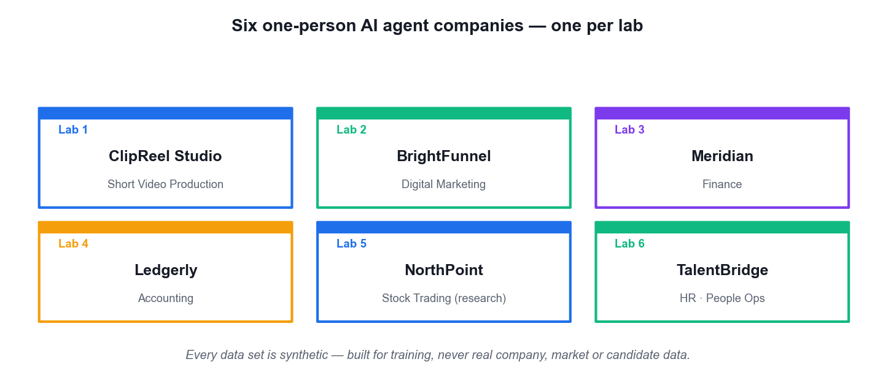
THE COURSE SIMULATION
Six One-Person AI Agent Companies
Each lab builds a different one-person company — so you see the same control model applied to six very different businesses.
Manage AI Agents with Paperclip (TGS-2023036646) · TGS-2023036646
© 2026 Tertiary Infotech Academy Pte Ltd
14

Slide 15
BEFORE YOU START
Briefing for Assessment
Do · Clear your desk
Place phones and other materials under the table or on the floor.
Don't · No recording
No photos or recording of assessment scripts.
1
2
Don't · No discussion
Work individually — no discussion during the assessment.
Do · Black or blue pen
Use a black or blue pen for hard-copy assessments.
3
4
Don't · No correction fluid
No liquid paper or correction tape may be used.
Do · Stop on time
Scripts are collected when time is up.
5
6
Manage AI Agents with Paperclip (TGS-2023036646) · TGS-2023036646
© 2026 Tertiary Infotech Academy Pte Ltd
15

Slide 16
FINAL ASSESSMENT
Assessment
Written Assessment (WA)
Short-Answer Questions (SAQ) · 5 questions · 1 hour · open book. Tests the underpinning knowledge (K1–K5).
Practical Performance (PP)
4 hands-on Paperclip tasks · 1 hour · open book. Tests the ability you built in the labs (A1–A4).
1
2
Open book
You may use the course slides, the Learner Guide and approved materials only.
Eligibility
A minimum of 75% attendance is required to be eligible for assessment and funding.
3
4
Result
You are assessed as Competent (C) or Not Yet Competent (NYC) on each instrument.
Appeals
An appeal process is available if you wish to contest an assessment outcome.
5
6
Manage AI Agents with Paperclip (TGS-2023036646) · TGS-2023036646
© 2026 Tertiary Infotech Academy Pte Ltd
16

Slide 17
ON ASSESSMENT DAY
Assessment Flow
1
2
3
4
5
TRAQOM survey
Digital attendance
Sit WA then PP
Submit on the LMS
Sign the record
Scan the QR code on the LMS
Scan the SSG assessment QR
Open book · 1 hour each
Upload your completed answers
Sign the Assessment Summary Record
REMEMBER
All five steps are mandatory for WSQ funding — missing the digital attendance or the TRAQOM survey can invalidate your claim.
Manage AI Agents with Paperclip (TGS-2023036646) · TGS-2023036646
© 2026 Tertiary Infotech Academy Pte Ltd
17

Slide 18
EXAMS.TERTIARYINFOTECH.COM
Practice Exam
Practise before the real thing
Try the practice questions at https://exams.tertiaryinfotech.com before the final assessment.
Same format
Short-answer knowledge questions in the same style as the Written Assessment.
1
2
Self-marked
Use it to find the topics you need to revisit, not to score yourself.
Free and unlimited
Attempt it as many times as you like during the course.
3
4
Manage AI Agents with Paperclip (TGS-2023036646) · TGS-2023036646
© 2026 Tertiary Infotech Academy Pte Ltd
18

Slide 19
WSQ FUNDING
Criteria for Funding
Attendance
A minimum attendance rate of 75%, based on the SSG Digital Attendance record.
Assessment
Complete both assessment components and be assessed as 'Competent'.
1
2
Digital attendance
Scan the SSG QR code for AM, PM and Assessment on every training day.
TRAQOM survey
Complete the mandatory TRAQOM course feedback survey on the LMS.
3
4
Manage AI Agents with Paperclip (TGS-2023036646) · TGS-2023036646
© 2026 Tertiary Infotech Academy Pte Ltd
19

Slide 20
LAB ENVIRONMENT
Set Up Before We Start
Node.js 20 or later
Paperclip requires Node 20+. Check with node --version.
A normal user shell
Never run onboarding from an elevated Administrator or root shell.
1
2
An agent runtime
One trainer-approved CLI runtime (e.g. Claude Code, Codex, Gemini CLI).
Git
Used to baseline each agent workspace so every change is a readable diff.
3
4
Lab repository
Clone the course labs — the link is on your LMS course page.
Synthetic data only
All six company data sets are fabricated for training. Never load real company, market or candidate data.
5
6
Manage AI Agents with Paperclip (TGS-2023036646) · TGS-2023036646
© 2026 Tertiary Infotech Academy Pte Ltd
20

Slide 21
CORE CONCEPTS
From a Single Agent to a Managed Agent Company
Manage AI Agents with Paperclip (TGS-2023036646) · TGS-2023036646
© 2026 Tertiary Infotech Academy Pte Ltd
21

Slide 22
THE SIX INGREDIENTS
What Makes a System 'Agentic'?
Reasoning
The model plans a sequence of steps instead of answering in one shot.
Tool use
It calls functions, CLIs and APIs to fetch live data or take real actions.
1
2
Memory
State carries context across turns — and, in Paperclip, across heartbeats.
Autonomy
It decides which tool to use and when the work is actually finished.
3
4
Collaboration
Several specialised agents divide the work and hand off between themselves.
Guardrails
Policies, budgets and approvals constrain what the agent may do.
5
6
Manage AI Agents with Paperclip (TGS-2023036646) · TGS-2023036646
© 2026 Tertiary Infotech Academy Pte Ltd
22

Slide 23
WHY A CONTROL PLANE
An LLM answers. An agent acts. A company coordinates.
Paperclip is the third layer — it does not make your agents smarter, it makes a team of them accountable.
Manage AI Agents with Paperclip (TGS-2023036646) · TGS-2023036646
© 2026 Tertiary Infotech Academy Pte Ltd
23

Slide 24
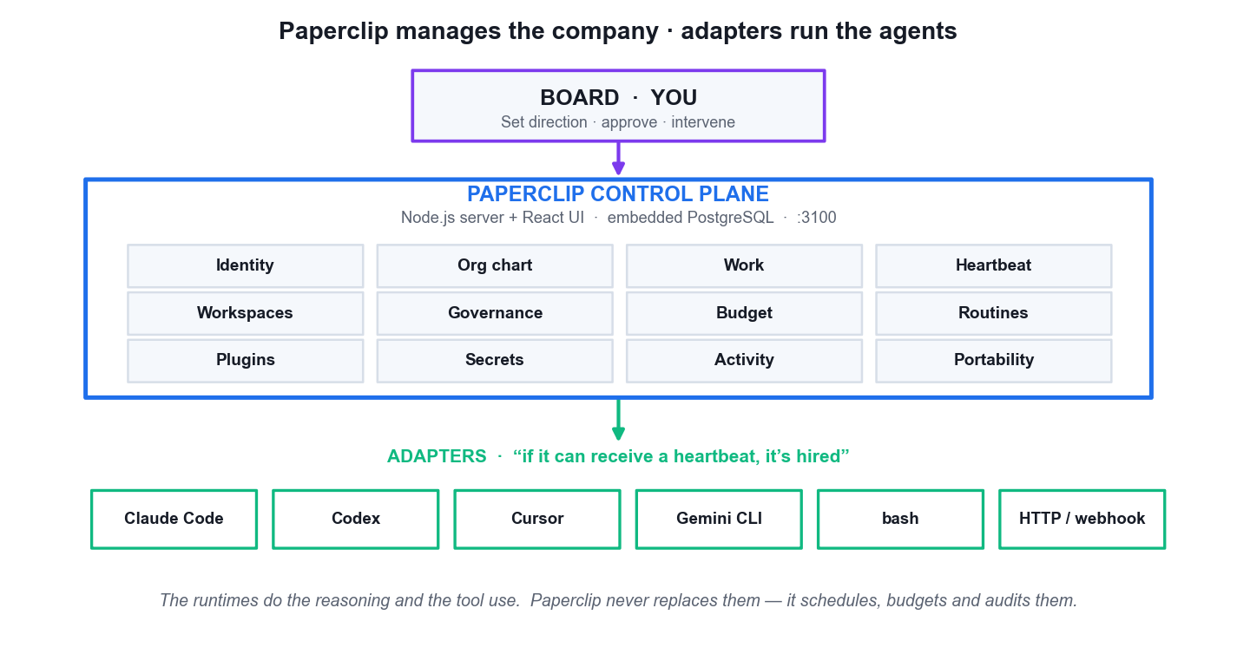
LO1 · ORCHESTRATE, DO NOT REPLACE, THE RUNTIME
Paperclip Control-Plane Architecture
Board · you
You set direction, approve governed actions and intervene. Authority never leaves the human.
The control plane
Stores companies, org charts, issues, budgets, secrets and the audit trail. Node.js + React on port 3100.
The adapters
Claude Code, Codex, Cursor, Gemini CLI, bash or an HTTP bot — these do the actual reasoning.
The separation
Organisational authority, runtime capability and verification evidence are kept deliberately apart.
Manage AI Agents with Paperclip (TGS-2023036646) · TGS-2023036646
© 2026 Tertiary Infotech Academy Pte Ltd
24

Slide 25
LO1 · SCOPE THE TOOL CORRECTLY
What Paperclip Is — and Is Not
IS · an organisational control plane
Org charts, issues, budgets, approvals and a durable audit trail for a team of agents.
IS · a runtime-agnostic scheduler
'If it can receive a heartbeat, it's hired.' It schedules and budgets agents without replacing them.
1
2
IS NOT · an agent framework
It does not dictate how your agent reasons, prompts or calls tools. That is the adapter's job.
IS NOT · a chatbot or workflow builder
No drag-and-drop canvas, no prompt manager, and not designed for a single-agent use case.
3
4
Choosing Paperclip is an organisational decision, not a modelling decision.
Manage AI Agents with Paperclip (TGS-2023036646) · TGS-2023036646
© 2026 Tertiary Infotech Academy Pte Ltd
25

Slide 26
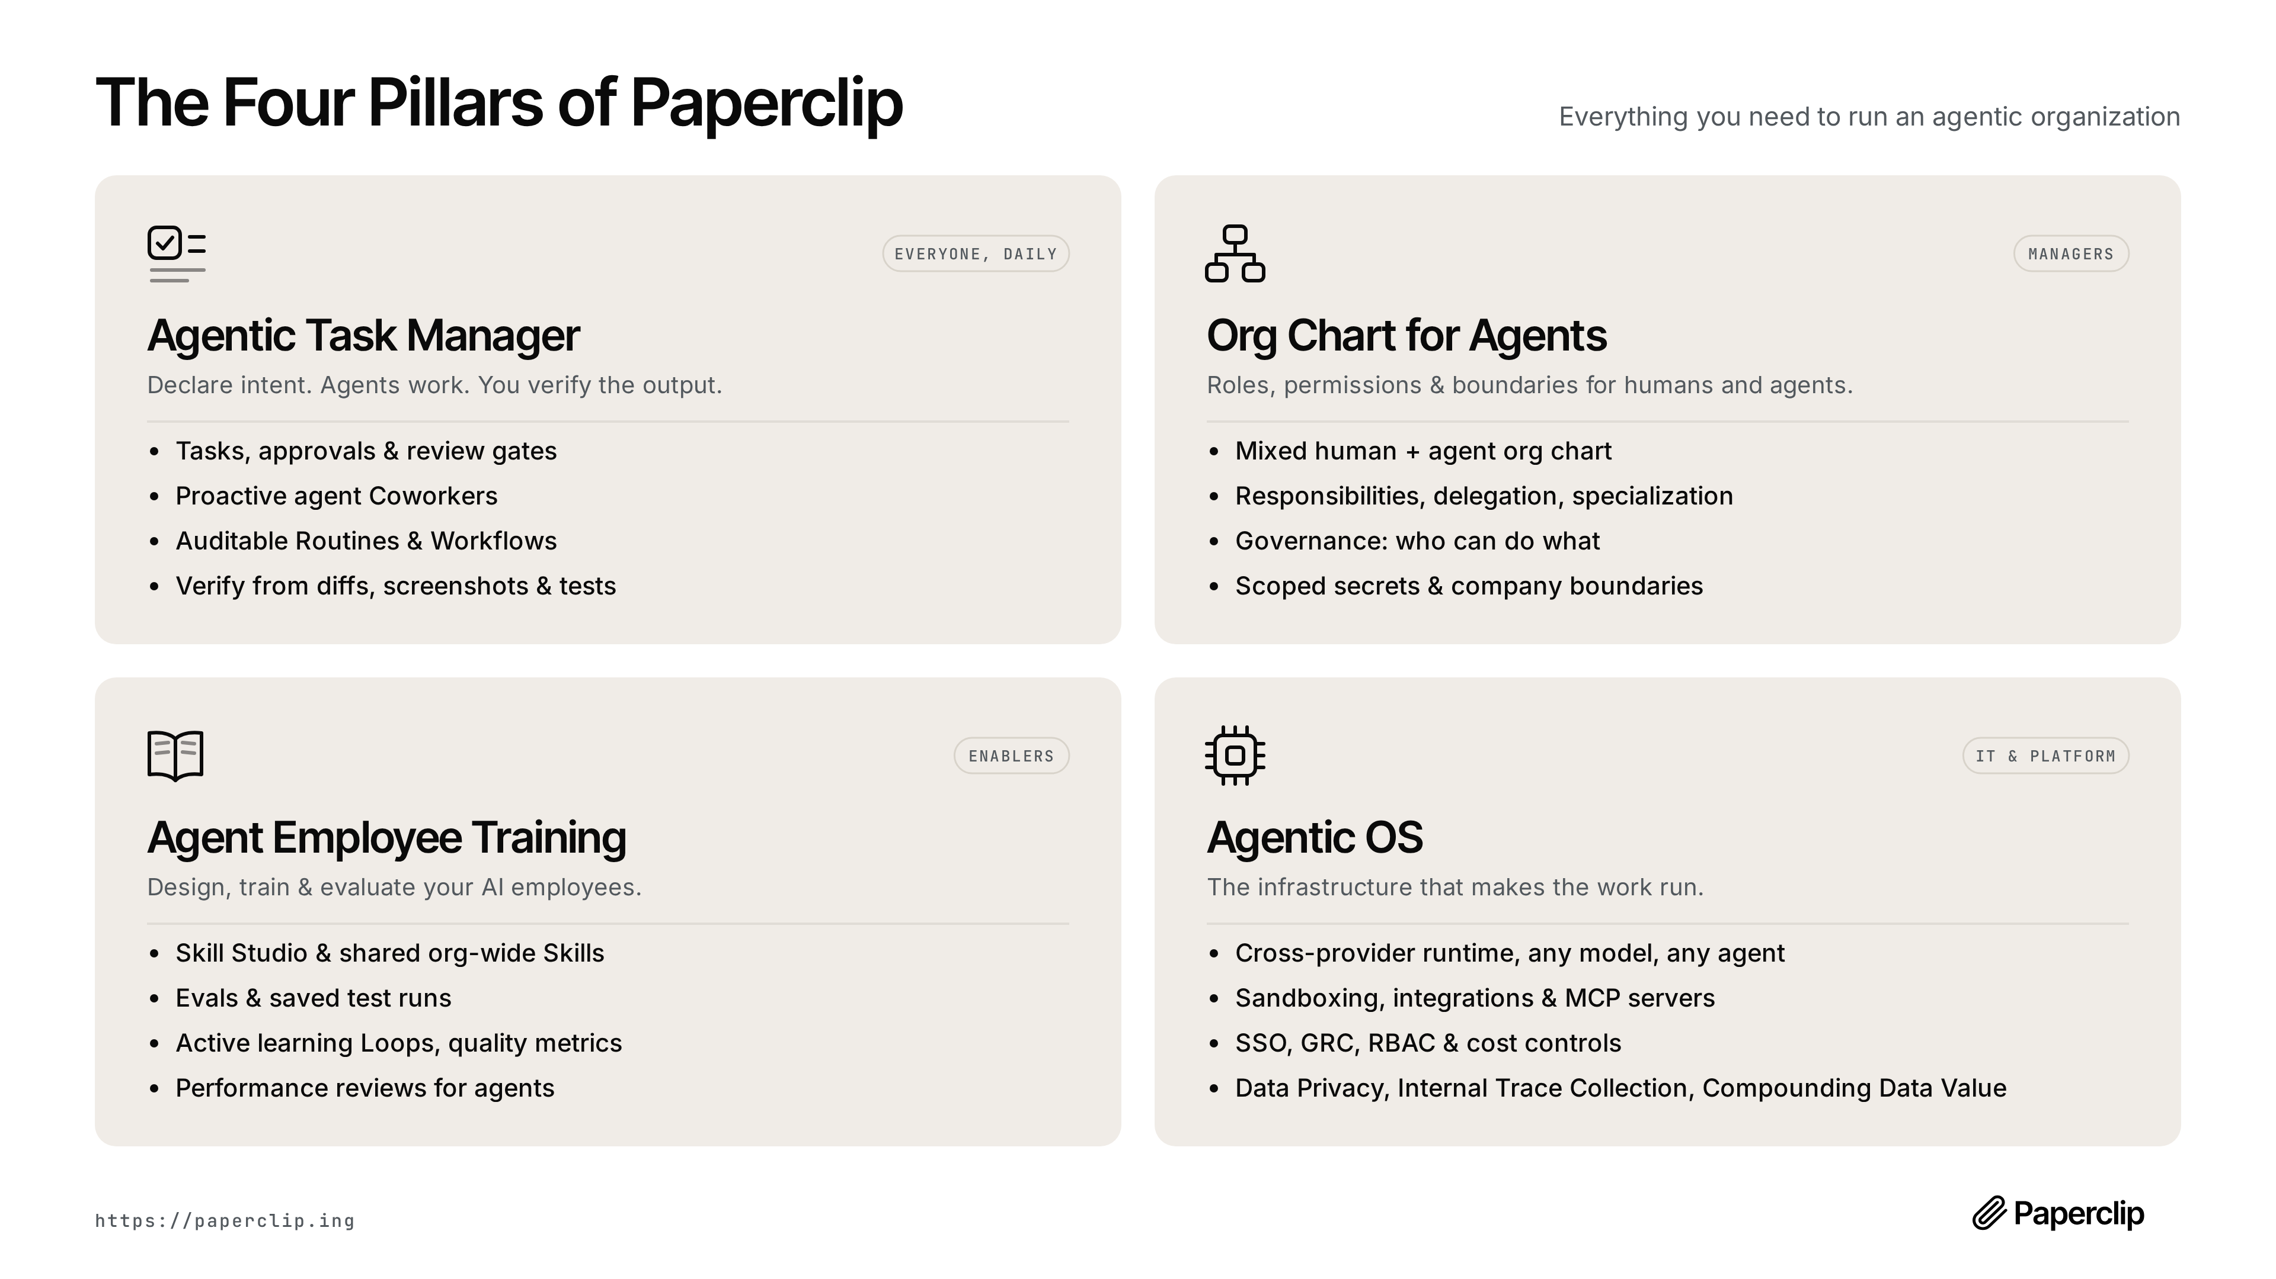
LO1 · THE PRODUCT MODEL
The Four Pillars of Paperclip
Agentic task manager · org chart for agents · agent employee training · agentic OS. Source: the official Paperclip project.
Manage AI Agents with Paperclip (TGS-2023036646) · TGS-2023036646
© 2026 Tertiary Infotech Academy Pte Ltd
26

Slide 27
LO1 · WHAT THE PLATFORM ACTUALLY CONTAINS
The Twelve Subsystems
Identity & org chart
Who exists, who reports to whom, and what each role may do.
Work & heartbeat
Issues with atomic checkout, woken by bounded execution bursts.
1
2
Workspaces & runtime
Isolated roots (git worktrees) and the adapter that runs there.
Governance & budget
Approval gates and caps enforced at checkout, not at billing.
3
4
Routines & plugins
Scheduled recurring work, and the skills library agents draw on.
Secrets, activity & portability
Scoped injection, a durable audit log, and export/import of a whole company.
5
6
Manage AI Agents with Paperclip (TGS-2023036646) · TGS-2023036646
© 2026 Tertiary Infotech Academy Pte Ltd
27

Slide 28
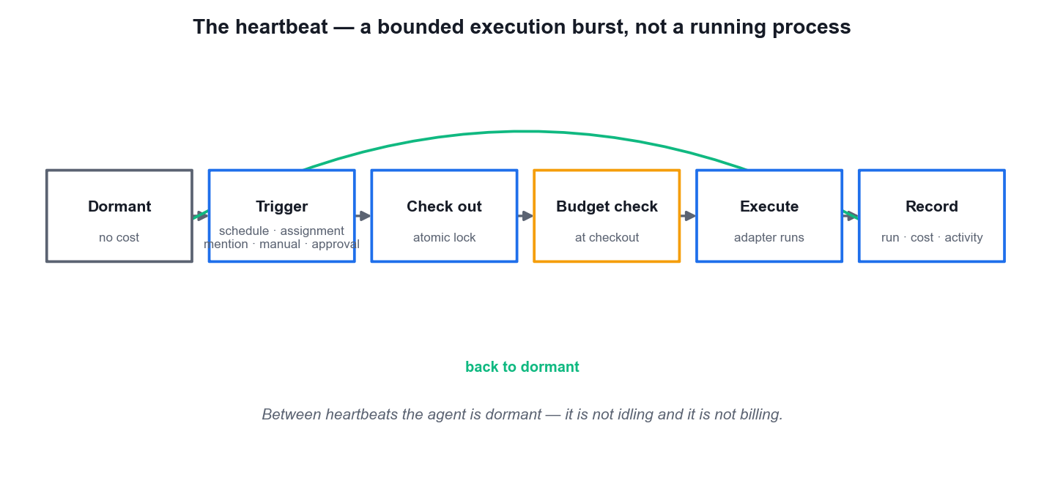
LO1 · THE EXECUTION MODEL
The Heartbeat — Bounded Execution, Not a Running Process
Dormant by default
Between heartbeats the agent is not idling and not billing.
Five triggers
A schedule/interval tick, a task assignment, an @-mention, a manual Run Heartbeat, or an approval being resolved.
Atomic checkout
An execution lock means two heartbeats can never double-work the same issue.
Budget checked first
The cap is tested at checkout — a runaway loop stops at the ceiling.
Manage AI Agents with Paperclip (TGS-2023036646) · TGS-2023036646
© 2026 Tertiary Infotech Academy Pte Ltd
28

Slide 29
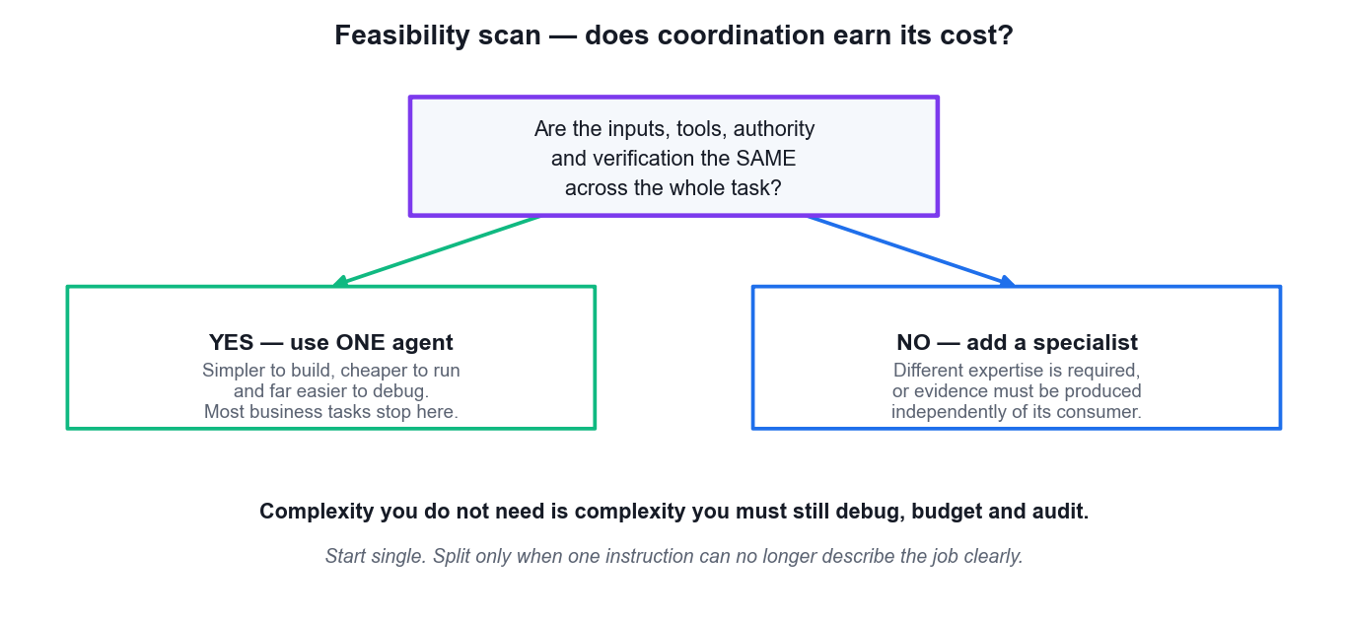
LO1 · THE MOST IMPORTANT DECISION IN THE COURSE
Feasibility Scan — Does Coordination Earn Its Cost?
Use ONE agent
When inputs, tools, authority and verification are the same across the whole task.
Add a specialist
Only when different expertise is required, or evidence must be produced independently.
The real cost
Every extra agent is another workspace, budget, instruction and audit trail to maintain.
Start single
Split only when one instruction can no longer describe the job clearly.
Manage AI Agents with Paperclip (TGS-2023036646) · TGS-2023036646
© 2026 Tertiary Infotech Academy Pte Ltd
29

Slide 30
LO1 · WHEN THE CONTROL PLANE PAYS FOR ITSELF
One Agent vs a Paperclip Agent Company
Dimension
One agent, run by hand
A Paperclip agent company
Direction
Restated in every prompt
A mission that flows down as goal lineage
Memory
Ends with the session
Persists across heartbeats in the control plane
Cost
Discovered on the invoice
Capped at checkout per company, project and agent
Authority
Implicit — whatever you allow
Explicit — org chart, roles and approvals
Evidence
Scrollback you must trust
Runs, comments, diffs and a durable activity log
Main risk
Context saturation
Coordination overhead you did not need
WHEN IT MATTERS The right answer is often still ONE agent. Reach for the company when the work has genuinely separable roles that must each be evidenced.
Manage AI Agents with Paperclip (TGS-2023036646) · TGS-2023036646
© 2026 Tertiary Infotech Academy Pte Ltd
30

Slide 31
LESSON PLAN · TIME ALLOCATION
Where Course Time Goes — Topic Weighting
WHAT THE DATA SHOWS
The four topics carry equal weighting — but Topics 3 and 4 are where the assessable practical skill sits, because that is where governance and verification are actually exercised.
Manage AI Agents with Paperclip (TGS-2023036646) · TGS-2023036646
© 2026 Tertiary Infotech Academy Pte Ltd
31

Slide 32
01
TOPIC 01
Fundamentals of Agentic AI and Paperclip
Agentic AI foundations · the control-plane model · the twelve subsystems · feasibility and when NOT to use multi-agent
Manage AI Agents with Paperclip (TGS-2023036646) · TGS-2023036646
© 2026 Tertiary Infotech Academy Pte Ltd
32

Slide 33
TOPIC WEIGHTING 25%
Key Concepts — Fundamentals of Agentic AI and Paperclip
Agentic AI adds reasoning, tool use, memory and autonomy on top of a language model, so the system completes work rather than only producing text.
Paperclip is an organisational control plane — a Node.js server with a React UI that coordinates agents, goals, work, cost and governance. It is not an agent framework and it does not perform the reasoning itself.
1
2
The defining separation: Paperclip manages the company; adapters run the agents. Organisational authority, runtime capability and verification evidence stay apart.
A company is the boundary for one mission, its human members, AI employees, projects, issues, budget and activity history. One deployment holds many companies.
3
4
Manage AI Agents with Paperclip (TGS-2023036646) · TGS-2023036646
© 2026 Tertiary Infotech Academy Pte Ltd
33

Slide 34
TOPIC WEIGHTING 25%
Key Concepts — Fundamentals of Agentic AI and Paperclip (continued)
The four pillars are the agentic task manager, the org chart for agents, agent employee training (skills and evaluations) and the agentic OS (runtime, sandboxing, MCP, RBAC and cost control).
Twelve subsystems make up the platform: identity, org chart, work, heartbeat, workspaces, governance, budget, routines, plugins, secrets, activity and portability.
1
2
A heartbeat is a bounded execution window with FIVE triggers: a schedule/interval tick, a task assignment, an @-mention in a comment, a manual Run Heartbeat, or an approval being resolved. Between heartbeats the agent is dormant — not idling and not billing.
Work is checked out atomically with an execution lock, so two heartbeats can never double-work the same issue or race past a budget ceiling.
3
4
Manage AI Agents with Paperclip (TGS-2023036646) · TGS-2023036646
© 2026 Tertiary Infotech Academy Pte Ltd
34

Slide 35
TOPIC WEIGHTING 25%
Key Concepts — Fundamentals of Agentic AI and Paperclip (continued)
'If it can receive a heartbeat, it's hired' — adapter type keys include claude_local, codex_local, gemini_local, opencode_local, cursor, pi_local and hermes_local, plus process, http and openclaw_gateway.
Feasibility comes before architecture: use one agent when the inputs, tools, authority and verification are the same across the whole task.
1
2
Add a specialist only when different expertise is genuinely required, or when evidence must be produced independently of the agent that will use it.
Installation is ready only when Node.js, the Paperclip configuration, the embedded database, server health, the browser UI and the doctor diagnostic all agree.
3
4
Manage AI Agents with Paperclip (TGS-2023036646) · TGS-2023036646
© 2026 Tertiary Infotech Academy Pte Ltd
35

Slide 36
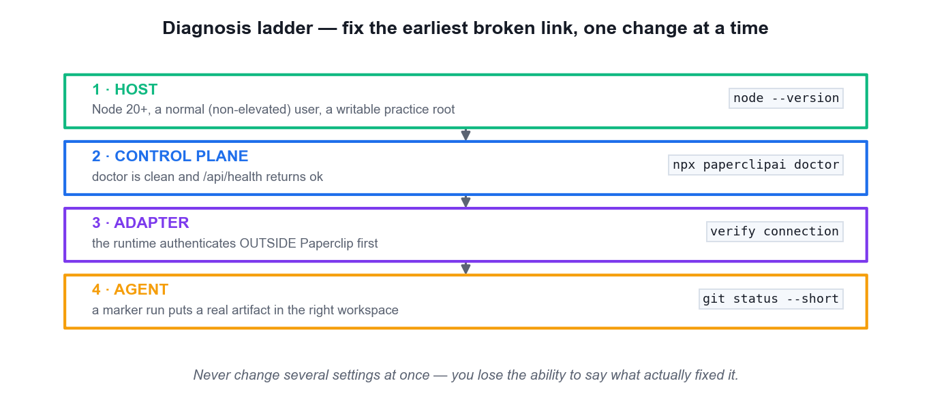
LO4 · TROUBLESHOOTING DISCIPLINE
Diagnosis Ladder — Fix the Earliest Broken Link
Host first
Node 20+, a normal non-elevated user, a writable practice root.
Then the control plane
doctor is clean and /api/health returns ok.
Then the adapter
The runtime must authenticate OUTSIDE Paperclip first.
Then the agent
A marker run puts a real artifact in the right workspace.
Manage AI Agents with Paperclip (TGS-2023036646) · TGS-2023036646
© 2026 Tertiary Infotech Academy Pte Ltd
36

Slide 37
LO2 · THE READINESS CHECKLIST
Installation Is Ready Only When Everything Agrees
Node.js
Major version 20 or later — the most common cause of a failed onboard.
Configuration & database
Written by onboard; the embedded PostgreSQL starts as the normal user.
1
2
Server health
GET /api/health returns an ok status.
Browser UI
http://localhost:3100 loads without a connection error.
3
4
Doctor
npx paperclipai doctor completes with no blocking error.
Evidence
All of the above recorded — with no credential ever captured.
5
6
A green badge is not evidence. An observable artifact is.
Manage AI Agents with Paperclip (TGS-2023036646) · TGS-2023036646
© 2026 Tertiary Infotech Academy Pte Ltd
37

Slide 38
LO1 · FROM A LANGUAGE MODEL TO AN AGENT
The Four Additions That Make an Agent
Addition
What it provides
What breaks without it
Reasoning / planning
Decomposes a goal into steps before acting, and re-plans when a step fails.
Answers in one shot; cannot recover from a wrong first move.
Tool use
Calls functions, CLIs and APIs to read live data and take real action.
The system can only talk about the work; it cannot do it.
Memory / state
Context carries across turns and across separate execution windows.
Every wake-up starts from nothing and repeats work already done.
Autonomy
Decides which tool, in which order, and when it is finished.
A human drives every step — a chatbot with extra latency.
WHEN IT MATTERS Add a fifth ingredient — several agents dividing the work — and you have a multi-agent system. That is where the interesting failures start.
Manage AI Agents with Paperclip (TGS-2023036646) · TGS-2023036646
© 2026 Tertiary Infotech Academy Pte Ltd
38

Slide 39
LO1 · FIVE ORGANISATIONAL PROBLEMS, NOT MODEL PROBLEMS
Why Coordination Is the Hard Part
DIRECTION
Each agent must know not only what to do but WHY — or it optimises the wrong thing very efficiently.
AUTHORITY
Who may hire, spend and ship. Left implicit it defaults to 'whatever the agent decided to try'.
1
2
ISOLATION
Two agents writing to the same place corrupts both pieces of work and destroys attribution.
COST
An agent in a retry loop does not get tired. Without a ceiling you discover the problem on the invoice.
3
4
EVIDENCE
'The agent says it is done' is not 'it is done'. Someone must check later, without taking anyone's word.
THE MAPPING
These five concerns are exactly what the twelve subsystems address — map each subsystem back to one.
5
6
Running one agent is a prompting problem. Running five is an organisational one.
Manage AI Agents with Paperclip (TGS-2023036646) · TGS-2023036646
© 2026 Tertiary Infotech Academy Pte Ltd
39

Slide 40
LO1 · THE ASSESSMENT USES THIS VOCABULARY
The Official Vocabulary — Learn It Verbatim
Term
The documentation's own definition
Company
A self-contained AI organisation with a single goal, a team of agents, a task board, and a budget.
Agent
An AI employee — a configured role with a specific job, a manager, and a monthly budget.
Task (issue)
A unit of work — like a ticket on a project board, except it is assigned to an AI agent, not a human.
Heartbeat
A scheduled execution window — when an agent wakes up, checks its inbox, and does work.
Adapter
The connection between Paperclip and the AI system that actually runs your agent.
Budget
A monthly spending cap that Paperclip enforces automatically so your agents never overspend.
Approval
A governance gate — a checkpoint where Paperclip pauses and asks you to sign off before an action proceeds.
WHEN IT MATTERS Notice what is absent: nothing about prompting, model selection or how an agent reasons. That omission is deliberate.
Manage AI Agents with Paperclip (TGS-2023036646) · TGS-2023036646
© 2026 Tertiary Infotech Academy Pte Ltd
40

Slide 41
LO1 · THREE LAYERS, THREE DIFFERENT PROBLEMS
LLM vs Agent vs Agent Company
Dimension
A language model
A single agent
A Paperclip company
What it does
Answers
Acts
Coordinates several actors
Memory
None beyond the prompt
Within one session
Across heartbeats, in the control plane
Authority
None
Whatever you allow implicitly
Explicit — org chart, roles and approvals
Cost visibility
Per request
Discovered on the invoice
Capped at checkout by company, project and agent
Evidence
The reply text
Scrollback you must trust
Runs, comments, diffs and a durable activity log
WHEN IT MATTERS Paperclip is the third layer. It does not make your agents smarter — it makes a team of them accountable.
Manage AI Agents with Paperclip (TGS-2023036646) · TGS-2023036646
© 2026 Tertiary Infotech Academy Pte Ltd
41

Slide 42
LO1 · SCOPING THE TOOL SAVES WASTED EVALUATION TIME
What Paperclip Is NOT
NOT an agent framework
It does not dictate how your agent reasons, prompts or calls tools. That is the adapter's job.
NOT a chatbot
There is no conversational surface for you to talk to a model through.
1
2
NOT a workflow builder
There is no drag-and-drop canvas of nodes and edges to wire together.
NOT a prompt manager
Prompts live with the runtime and the skill, not in a prompt library inside Paperclip.
3
4
NOT for a single agent
One agent does not need an org chart — the coordination overhead would be pure cost.
SO WHAT IS IT?
An organisational control plane: Node.js plus React on port 3100, backed by PostgreSQL on port 54329.
5
6
Paperclip manages the company. Adapters run the agents.
Manage AI Agents with Paperclip (TGS-2023036646) · TGS-2023036646
© 2026 Tertiary Infotech Academy Pte Ltd
42

Slide 43
LO1 · THE MOST COMMERCIALLY USEFUL JUDGEMENT
The Feasibility Scan — One Agent or a Team?
Factor
Points to ONE agent
Points to a TEAM
Separability
One instruction still describes the job clearly.
The instruction has become a list of unrelated responsibilities.
Expertise
One skill set covers it.
Genuinely different expertise is required for different parts.
Independent evidence
The doer can reasonably check their own work.
Evidence must be produced INDEPENDENTLY of whoever consumes it.
Observability
Inputs and outputs are already observable.
The same — a prerequisite either way, not a reason to split.
Cost of coordination
Low volume, short task.
The work recurs often enough to amortise the setup.
WHEN IT MATTERS The test is one question: are the INPUTS, TOOLS, AUTHORITY and VERIFICATION the same across the whole task? If yes, use one agent.
Manage AI Agents with Paperclip (TGS-2023036646) · TGS-2023036646
© 2026 Tertiary Infotech Academy Pte Ltd
43

Slide 44
LO1 · REACH FOR ONE AGENT AND BE ARGUED OUT OF IT
Should This Work Become an Agent Company?
YES — stay with ONE agent
Are the inputs, tools,
authority and verification
the SAME across the
whole task?
One instruction still describes the job clearly. Splitting adds nothing but surface area to debug, budget and audit.
NO — build the company
Different expertise, or evidence must be produced independently of whoever will consume it. Split into roles, one transformation each.
Sanity check before you build anything: write the mission as one sentence. If you cannot, you do not understand the work well enough to delegate it.
Manage AI Agents with Paperclip (TGS-2023036646) · TGS-2023036646
© 2026 Tertiary Infotech Academy Pte Ltd
44

Slide 45
LO1 · KNOW WHERE TO LOOK WHEN SOMETHING MISBEHAVES
Twelve Subsystems — Who Owns Which Problem?
Subsystem
The question it answers
Identity · Org chart
Who is this, who do they report to, and what may they do?
Work · Heartbeat
What needs doing, who owns it now, and when does an agent wake?
Workspaces
Where does this agent's work live, and who else can touch it?
Governance · Budget
Which actions need a human decision, and what is the ceiling?
Routines · Plugins
What recurs unasked, and how do we extend without forking?
Secrets
Where do credentials live, and how do they reach a run without leaking?
Activity · Portability
What happened, in order and durably — and how do we move it?
WHEN IT MATTERS You do not need to recite the twelve. You should be able to say which one owns a given problem — that is how you know where to look.
Manage AI Agents with Paperclip (TGS-2023036646) · TGS-2023036646
© 2026 Tertiary Infotech Academy Pte Ltd
45

Slide 46
WHAT YOU'LL DO
Hands-On Labs — Fundamentals of Agentic AI and Paperclip
Lab 1
—
—
• Install Paperclip and Prove the Control Plane (ClipReel Studio)
• ClipReel Studio (Short Video Production)
• —
• —
Manage AI Agents with Paperclip (TGS-2023036646) · TGS-2023036646
© 2026 Tertiary Infotech Academy Pte Ltd
46

Slide 47
LAB 1 · HANDS-ON
Install Paperclip and Prove the Control Plane (ClipReel Studio)
SIMULATED COMPANY · ClipReel Studio (Short Video Production)
You prepare a dedicated synthetic practice root for ClipReel Studio, a one-person short-video production company, verify the supported Node.js runtime, onboard Paperclip as a normal (non-elevated) user, and then inspect BOTH the built-in diagnostic and the live health endpoint. Proving the control plane before you hire any agent matters because every later adapter, budget or heartbeat failure is far easier to isolate when the platform itself has a recorded clean baseline.
YOU'LL BUILD
MAPS TO
A running Paperclip instance at http://localhost:3100 plus evidence/lab01-installation.md recording the Node/npm versions, the doctor summary and the /api/health response — with no credentials captured.
LO1: Explain the control-plane / runtime boundary and verify a healthy local Paperclip installation with observable evidence.
Tools: Node.js 20+, npm/npx, Paperclip CLI, browser, terminal or PowerShell
Full step-by-step procedure: Learner Guide, Lab 1 · labs/ folder
Manage AI Agents with Paperclip (TGS-2023036646) · TGS-2023036646
© 2026 Tertiary Infotech Academy Pte Ltd
47

Slide 48
LAB 1 · PROCESS MAP
How Lab 1 Runs
1
2
3
4
5
Prepare the practice root
Verify Node.js 20+
Onboard Paperclip
Run doctor
Prove /api/health
separate workspace + evidence folders
the top cause of a failed onboard
normal user shell — never sudo
fix the EARLIEST error first
record the clean baseline
THE POINT
LO1: Explain the control-plane / runtime boundary and verify a healthy local Paperclip installation with observable evidence.
Manage AI Agents with Paperclip (TGS-2023036646) · TGS-2023036646
© 2026 Tertiary Infotech Academy Pte Ltd
48

Slide 49
LAB 1 · VERIFY
Install Paperclip and Prove the Control Plane (ClipReel Studio)
✅ Expected result
npx paperclipai doctor completes with no unresolved blocking error, GET http://localhost:3100/api/health returns status ok, the browser loads the Paperclip UI, and evidence/lab01-installation.md records all three checks with no credential or personal identifier.
IF IT DOESN'T WORK
Embedded PostgreSQL refuses to start
The browser cannot reach port 3100
npx resolves against a private registry
Confirm the shell is NOT elevated. Stop the process and re-run onboarding as the normal user who owns the practice folder.
Run npx paperclipai doctor, then npx paperclipai run, and query /api/health again BEFORE touching any firewall setting.
Retry with npx --registry https://registry.npmjs.org paperclipai onboard --yes and review the global npm registry configuration afterwards.
Manage AI Agents with Paperclip (TGS-2023036646) · TGS-2023036646
© 2026 Tertiary Infotech Academy Pte Ltd
49

Slide 50
LAB 1 · TROUBLESHOOTING
Install Paperclip and Prove the Control Plane (ClipReel Studio)
⚠ Embedded PostgreSQL refuses to start
Confirm the shell is NOT elevated. Stop the process and re-run onboarding as the normal user who owns the practice folder.
⚠ The browser cannot reach port 3100
Run npx paperclipai doctor, then npx paperclipai run, and query /api/health again BEFORE touching any firewall setting.
⚠ npx resolves against a private registry
Retry with npx --registry https://registry.npmjs.org paperclipai onboard --yes and review the global npm registry configuration afterwards.
CHALLENGE
REFLECTION
Run npx paperclipai env and record ONLY the non-sensitive instance name, bind mode and port in your evidence note. Do not paste the full output.
Why does a healthy Paperclip API prove the control plane but say nothing about whether a Claude Code, Codex, Gemini or Cursor runtime is ready?
Manage AI Agents with Paperclip (TGS-2023036646) · TGS-2023036646
© 2026 Tertiary Infotech Academy Pte Ltd
50

Slide 51
TOPIC RECAP
Recap — Fundamentals of Agentic AI and Paperclip
• You can now: LO1: Explain the control-plane / runtime boundary and verify a healthy local Paperclip installation with observable evidence.
• Agentic AI adds reasoning, tool use, memory and autonomy on top of a language model, so the system completes work rather than only producing text.
• Paperclip is an organisational control plane — a Node.js server with a React UI that coordinates agents, goals, work, cost and governance. It is not an agent framework and it does not perform the reasoning itself.
• The defining separation: Paperclip manages the company; adapters run the agents. Organisational authority, runtime capability and verification evidence stay apart.
Manage AI Agents with Paperclip (TGS-2023036646) · TGS-2023036646
© 2026 Tertiary Infotech Academy Pte Ltd
51

Slide 52
02
TOPIC 02
Building AI Agents with Paperclip
Install and verify · company and mission · the CEO · org chart · runtime adapters · workspaces, instructions and secrets
Manage AI Agents with Paperclip (TGS-2023036646) · TGS-2023036646
© 2026 Tertiary Infotech Academy Pte Ltd
52

Slide 53
TOPIC WEIGHTING 25%
Key Concepts — Building AI Agents with Paperclip
Onboarding with paperclipai onboard --yes downloads Paperclip, writes the configuration, initialises the embedded PostgreSQL and serves the UI on port 3100.
Deployment mode is a security decision: local_trusted is the default and requires no login; authenticated+private and authenticated+public widen reach and require real authentication.
1
2
The onboarding wizard captures the company name, the mission statement and the team lead, then verifies connectivity to your chosen local agent runtime.
A mission must be measurable. 'Grow the channel' cannot be verified; 'publish 8 short videos per month at ≥5% average watch-through' can.
3
4
Manage AI Agents with Paperclip (TGS-2023036646) · TGS-2023036646
© 2026 Tertiary Infotech Academy Pte Ltd
53

Slide 54
TOPIC WEIGHTING 25%
Key Concepts — Building AI Agents with Paperclip (continued)
Paperclip enforces a strict hierarchy: every agent reports to exactly ONE manager, and the CEO is the only agent with no manager. The CEO owns goal alignment, decomposition and final synthesis, and may propose further hires under approval.
Every agent carries a role, a manager, an adapter, an instruction file, a heartbeat and an individual budget. Those six fields are the agent's whole contract.
1
2
A role instruction states purpose, allowed inputs, the output schema, explicit exclusions and the escalation path — not a personality.
Each agent gets a dedicated workspace: a separate local root for one role's files and evidence, isolated with git worktrees so changes are attributable.
3
4
Manage AI Agents with Paperclip (TGS-2023036646) · TGS-2023036646
© 2026 Tertiary Infotech Academy Pte Ltd
54

Slide 55
TOPIC WEIGHTING 25%
Key Concepts — Building AI Agents with Paperclip (continued)
Secrets live in the runtime or in Paperclip's secret store with scoped injection at heartbeat time. They never appear in prompts, lab notes or Git.
Skills are reusable agent capabilities imported from a path or URL into an org-wide library, then attached to specific agents — capability without retraining.
1
2
Adapter readiness is proved by a marker run, not by the presence of configuration: an agent that cannot produce an observable artifact is not connected.
Diagnose along a ladder — host, control plane, adapter, agent — and fix the earliest broken link before changing anything downstream.
3
4
Manage AI Agents with Paperclip (TGS-2023036646) · TGS-2023036646
© 2026 Tertiary Infotech Academy Pte Ltd
55

Slide 56
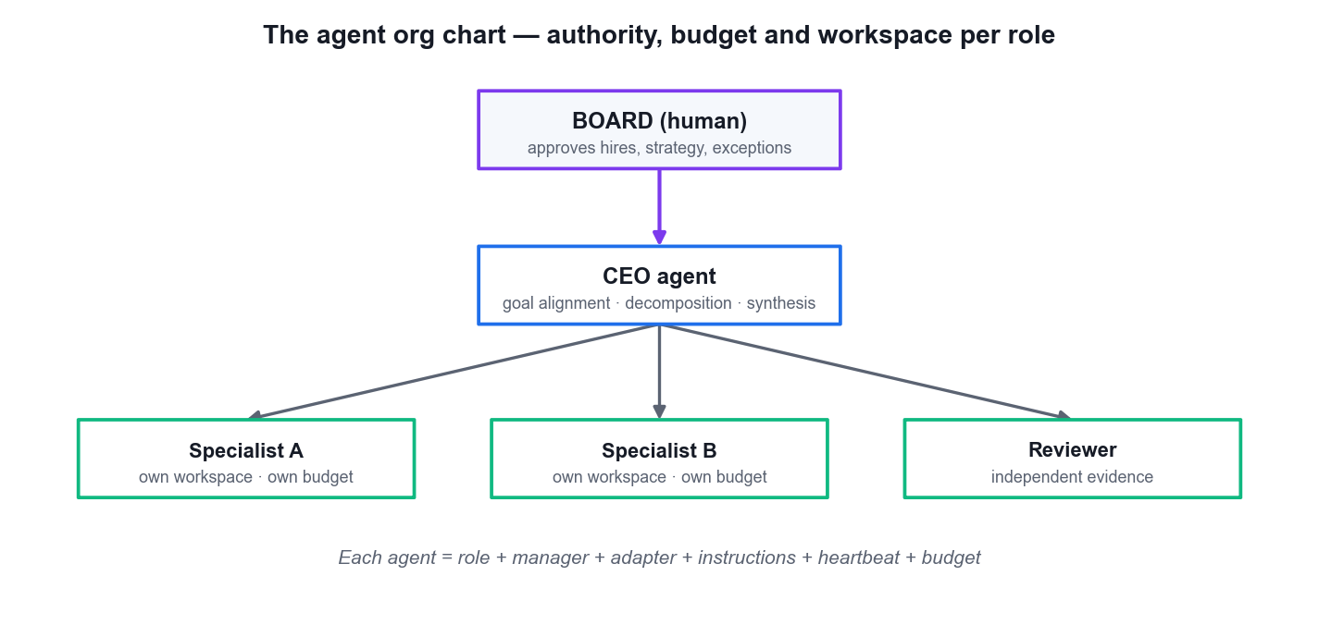
LO2 · ACCOUNTABILITY HAS A SHAPE
The Agent Org Chart
Board approves
Hires, strategy and material exceptions stay with the human.
The CEO owns alignment
Goal alignment, decomposition and final synthesis.
Specialists own transformations
One distinct job, one authority boundary, one deliverable.
Six fields per agent
Role · manager · adapter · instructions · heartbeat · budget.
Manage AI Agents with Paperclip (TGS-2023036646) · TGS-2023036646
© 2026 Tertiary Infotech Academy Pte Ltd
56

Slide 57
LO2 · WRITING THE ROLE
A Role Instruction Is a Contract, Not a Personality
Section
What it states
Why it matters
Purpose
The single transformation this role owns
Prevents scope drift
Allowed inputs
Which files, data and sources may be read
Confines the blast radius
Output schema
The artifact, its path and its required fields
Makes acceptance objective
Exclusions
What this role must never do
The most valuable section
Escalation
When to stop and ask the board
Keeps authority explicit
WHEN IT MATTERS If two roles could both plausibly do the task, your instructions are not finished.
Manage AI Agents with Paperclip (TGS-2023036646) · TGS-2023036646
© 2026 Tertiary Infotech Academy Pte Ltd
57

Slide 58
LO2 · SEPARATE CONTEXT FROM AUTHORITY
Workspaces, Secrets and Skills
Dedicated workspace
One local root per role, isolated with git worktrees so every change is attributable to exactly one agent.
Git baseline
Commit an empty baseline so the later diff means what you think it means.
1
2
Secrets stay out
Credentials live in the runtime or the Paperclip secret store, injected at heartbeat time — never in prompts, notes or Git.
Skills are capability
Import a skill from a path or URL into the org-wide library, then attach it to a specific agent.
3
4
Adapters bridge capability
Match role complexity, session needs and tool access to the adapter you choose.
Prove it with a marker run
Configuration that has never produced an artifact is not a connection.
5
6
Manage AI Agents with Paperclip (TGS-2023036646) · TGS-2023036646
© 2026 Tertiary Infotech Academy Pte Ltd
58

Slide 59
LO2 · HIRING IS A CONFIGURATION DECISION
The Six Fields That Define Every Agent
Field
What it controls
Get it wrong and
Role
What this agent is for — the single transformation it owns.
Scope drifts into a neighbouring role's work.
Manager
Its reporting line. Exactly one, except for the CEO.
Accountability has no shape; nobody owns the outcome.
Adapter
Which runtime actually executes its work.
The agent is configured but can never run.
Instructions
Its contract: purpose, inputs, output schema, exclusions, escalation.
Acceptance becomes a matter of opinion.
Heartbeat
When it wakes, and on which triggers.
It either never wakes, or wakes and bills when idle.
Budget
Its individual monthly ceiling.
A retry loop spends until someone reads the invoice.
WHEN IT MATTERS Paperclip enforces a strict hierarchy: every agent reports to exactly ONE manager, and the CEO is the only agent with no manager.
Manage AI Agents with Paperclip (TGS-2023036646) · TGS-2023036646
© 2026 Tertiary Infotech Academy Pte Ltd
59

Slide 60
LO2 · A CONTRACT, NOT A PERSONALITY
The Five Instruction Sections and Why Each Matters
Section
States
Why it matters
PURPOSE
The single transformation this role owns
Prevents scope drift into a neighbouring role's work.
ALLOWED INPUTS
Which files, data and sources may be read
Confines the blast radius when something goes wrong.
OUTPUT SCHEMA
The artifact, its path, and its required fields
Makes acceptance objective rather than a matter of opinion.
EXCLUSIONS
What this role must NEVER do
The most valuable section — and the one people leave out.
ESCALATION
When to stop and ask the board
Keeps human authority explicit instead of assumed.
WHEN IT MATTERS Tone does not constrain behaviour; structure does. If two roles could each plausibly claim the same task, your instructions are not finished.
Manage AI Agents with Paperclip (TGS-2023036646) · TGS-2023036646
© 2026 Tertiary Infotech Academy Pte Ltd
60

Slide 61
LO2 · FROM THE OFFICIAL DOCUMENTATION
Suggested Starting Budgets by Seniority
Role
Suggested monthly budget
The reasoning
CEO
$30–50 per month
Owns alignment, decomposition and synthesis — it wakes on more events than anyone else.
Manager (CTO or CMO)
$20–40 per month
Coordinates a sub-team, so it runs more often than a worker but less than the CEO.
Worker agent
$10–25 per month
One transformation, run on assignment. The cheapest role to cap tightly.
Company (total)
Set BEFORE the first hire
Enforcement happens at checkout, so the cap must exist before anyone can check out work.
WHEN IT MATTERS These are a sanity check on your own numbers, not a rule. A cap you would be unhappy to actually pay is set too high.
Manage AI Agents with Paperclip (TGS-2023036646) · TGS-2023036646
© 2026 Tertiary Infotech Academy Pte Ltd
61

Slide 62
LO2 · ALMOST EVERY FAULT IS 'WHICH STEP FAILED?'
The Six-Step Heartbeat Execution Arc
1
2
3
4
5
Trigger
Adapter invocation
Process spawn
Paperclip API calls
Result capture
Schedule, assignment, mention, manual or approval
Paperclip calls the configured adapter
The runtime process starts in the workspace
The agent reads work and writes results back
Output, artifacts and token usage recorded
STEP 6 · RUN RECORD STORAGE
The run, its cost and its activity entries are persisted. This rarely fails — but if it does, the audit trail has a gap you must explain.
Manage AI Agents with Paperclip (TGS-2023036646) · TGS-2023036646
© 2026 Tertiary Infotech Academy Pte Ltd
62

Slide 63
LO2 · DIAGNOSING A HEARTBEAT
Where Each Heartbeat Step Fails
Step
The usual failure
First thing to check
1 · Trigger
Nothing assigned and the interval is off (the default)
The assignee. Creating an issue does not wake anyone.
2 · Adapter invocation
Adapter misconfigured, or runtime not authenticated
Run the runtime's own CLI directly and sign in.
3 · Process spawn
The binary is missing, or the sandbox cannot start
The runtime install, outside Paperclip.
4 · API calls
Checkout conflict (409), or the cross-issue write limit of 20
Whether another agent already holds the issue.
5 · Result capture
The process is lost mid-run — error kind process_lost
The run log. Resume recovers it; a fresh run is not needed.
WHEN IT MATTERS Session persistence records a session ID before and after each run. If the pair differs the session rotated; if it matches, the conversation continued.
Manage AI Agents with Paperclip (TGS-2023036646) · TGS-2023036646
© 2026 Tertiary Infotech Academy Pte Ltd
63

Slide 64
LO2 · READ THE STATE BEFORE YOU DIAGNOSE
The Seven Agent States
1
active
Enabled and ready for heartbeats.
2
idle
Active, but no heartbeat is currently running.
3
running
A heartbeat is in progress right now.
4
error
The last heartbeat failed — not working, and did not stop gracefully.
5
paused
Deliberately stopped, by you or automatically on hitting the budget limit.
6
terminated
Permanently deactivated. NOT reversible.
7
pending_approval
Hired but awaiting board approval before it may run.
8
Run statuses differ
Runs are queued, running, succeeded, failed, timed out or cancelled — plus the error kind process_lost.
Pause is reversible. Terminate is not. Read the menu item twice before clicking.
Manage AI Agents with Paperclip (TGS-2023036646) · TGS-2023036646
© 2026 Tertiary Infotech Academy Pte Ltd
64

Slide 65
LO2 · MANAGED BUNDLE OR EXTERNAL VIA ROOTPATH
The Four Instruction Files
File
Answers
Loaded
AGENTS.md
The operating manual — the entry file, and the default.
Every run. Keep it the map, not the whole territory.
SOUL.md
Persona and decision philosophy — how this role weighs trade-offs.
When judgement is needed, not on every wake.
HEARTBEAT.md
The per-heartbeat checklist — what to do on every single wake.
Every run. This is the file that costs you on every heartbeat.
TOOLS.md
Available tools and API notes — what this role may call.
When the agent needs to know its own capability surface.
WHEN IT MATTERS The split matters for cost as much as clarity: material needed on every run is separated from material that is only occasionally relevant.
Manage AI Agents with Paperclip (TGS-2023036646) · TGS-2023036646
© 2026 Tertiary Infotech Academy Pte Ltd
65

Slide 66
LO2 · COCKPIT INSTRUMENTS, NOT AN INVESTIGATION TOOL
Reading the Dashboard at a Glance
Signal
Healthy
Needs attention
Agents enabled
Mostly active or running
Any in error, or unexpectedly paused
Tasks in progress
Work is moving
Nothing in progress for hours, or many blocked
Month spend
Climbing predictably
A sudden jump, or active budget incidents
Pending approvals
Queue manageable
Approvals piling up unattended
Recent activity
Steady, understandable motion
Long silence, or repeated failures
WHEN IT MATTERS The healthy pattern for a small company is ONE agent running while the others stay active — otherwise you cannot attribute a change by timing alone.
Manage AI Agents with Paperclip (TGS-2023036646) · TGS-2023036646
© 2026 Tertiary Infotech Academy Pte Ltd
66

Slide 67
LO2 · THE LAST THREE SHOW AS 'COMING SOON' IN THE UI
Adapter Type Keys — The Eleven
1
claude_local
Claude Code running locally.
2
codex_local
OpenAI Codex CLI running locally.
3
gemini_local
Gemini CLI running locally.
4
opencode_local
OpenCode running locally.
5
cursor
Cursor — local and cloud variants exist.
6
pi_local
Pi running locally.
7
hermes_local
Hermes running locally.
8
grok_local
Grok running locally.
9
process
An arbitrary local process.
10
http
An HTTP or webhook endpoint.
11
openclaw_gateway
OpenClaw via its gateway.
Manage AI Agents with Paperclip (TGS-2023036646) · TGS-2023036646
© 2026 Tertiary Infotech Academy Pte Ltd
67

Slide 68
LO2 · READ THE DEFAULTS BEFORE UNATTENDED OPERATION
Adapter Defaults That Cost You Money
maxTurnsPerRun · 300
The Claude Code adapter defaults to a maximum of 300 turns per run. That is a lot of tokens if a loop goes wrong.
dangerouslySkipPermissions · true
The Claude Code adapter default. Know it is set before you let an agent run unattended.
1
2
Sandbox timeout · 14,400s
Four hours. A stuck run holds the workspace for that long unless you intervene.
Look before you leave it
Every one of these is a number you should read during configuration, not after an incident.
3
4
Adapter readiness is proved by a marker run — never by a saved configuration.
Manage AI Agents with Paperclip (TGS-2023036646) · TGS-2023036646
© 2026 Tertiary Infotech Academy Pte Ltd
68

Slide 69
LO2 · A DEGRADED WORKSPACE LOOKS LIKE A LAZY AGENT
The Workspace Lifecycle
1
2
3
4
5
6
▶
▶
▶
▶
▶
provisioning — being created
validating — being checked
ready — usable by the agent
degraded — usable, but something is wrong
repairing — being fixed
failed / archived — unusable, or retired
Manage AI Agents with Paperclip (TGS-2023036646) · TGS-2023036646
© 2026 Tertiary Infotech Academy Pte Ltd
69

Slide 70
LO2 · CONTEXT ECONOMY
Skills — Capability on Demand, Not in Every Prompt
A skill is a reusable instruction document an agent loads only when relevant. The economy is the point: ten skills, but not ten skills loaded per heartbeat.
skills/
└── code-review/
├── SKILL.md
└── references/
└── examples.md
# SKILL.md frontmatter
---
name: code-review
description: >
Use when asked to review a pull
request or code diff.
Don't use when writing new code
from scratch.
---
DESCRIPTION IS DECISION LOGIC
Write when to use it AND when not to — that sentence is what the agent reads to decide whether to load the skill at all.
COMPANY-SCOPED
Skills are never shared across companies. Folders may nest up to four levels deep.
ATTACHED AT HIRE OR LATER
Via desiredSkills at hire time, or later through the skills sync endpoint with mode add, remove or replace.
A DOCUMENTED CONTRADICTION
The Skills API says bundled skills are force-unioned into every agent; the newer CLI page says they are not. Verify on your own install.
Manage AI Agents with Paperclip (TGS-2023036646) · TGS-2023036646
© 2026 Tertiary Infotech Academy Pte Ltd
70

Slide 71
WHAT YOU'LL DO
Hands-On Labs — Building AI Agents with Paperclip
Lab 2
Lab 3
—
• Create the BrightFunnel Company, Mission and CEO (Digital Marketing)
• BrightFunnel Marketing (Digital Marketing)
• Build the Meridian Reporting Tree and Validate Runtime Boundaries (Finance)
• Meridian Finance Desk (Finance)
• —
Manage AI Agents with Paperclip (TGS-2023036646) · TGS-2023036646
© 2026 Tertiary Infotech Academy Pte Ltd
71

Slide 72
LAB 2 · HANDS-ON
Create the BrightFunnel Company, Mission and CEO (Digital Marketing)
SIMULATED COMPANY · BrightFunnel Marketing (Digital Marketing)
You stand up BrightFunnel Marketing — a one-person digital marketing company — as a Paperclip company. You write a MEASURABLE mission (a target, a metric and a boundary), hire the Marketing Director as CEO, connect one trainer-approved agent runtime, and set the company budget cap BEFORE any agent is allowed to run. The order matters: a company that gains a runtime before it gains a cap can spend without a ceiling.
YOU'LL BUILD
MAPS TO
A BrightFunnel company in Paperclip with the exact synthetic mission, a hardened Marketing Director CEO on a verified adapter, a saved company budget cap, a dedicated workspace and a redacted configuration baseline in evidence/.
LO2: Create a goal-aligned Paperclip company with a measurable mission, a hardened CEO agent and enforced company-level caps.
Tools: Paperclip onboarding wizard, Agent Configuration, one approved adapter runtime, text editor
Full step-by-step procedure: Learner Guide, Lab 2 · labs/ folder
Manage AI Agents with Paperclip (TGS-2023036646) · TGS-2023036646
© 2026 Tertiary Infotech Academy Pte Ltd
72

Slide 73
LAB 2 · PROCESS MAP
How Lab 2 Runs
1
2
3
4
5
Create the company
Set the company cap
Hire the CEO
Write the role contract
Confine + verify runtime
the exact measurable mission
the outermost ring, before hiring
Marketing Director owns alignment
purpose, inputs, schema, exclusions
own workspace, then agent cap
THE POINT
LO2: Create a goal-aligned Paperclip company with a measurable mission, a hardened CEO agent and enforced company-level caps.
Manage AI Agents with Paperclip (TGS-2023036646) · TGS-2023036646
© 2026 Tertiary Infotech Academy Pte Ltd
73

Slide 74
LAB 2 · VERIFY
Create the BrightFunnel Company, Mission and CEO (Digital Marketing)
✅ Expected result
BrightFunnel exists with the exact mission text; the Marketing Director is the sole top-level agent with a verified adapter, a confined workspace and an instruction file; the agent cap (SGD 15) is below the company cap (SGD 40); and the baseline note contains no key, token or connection string.
IF IT DOESN'T WORK
The adapter verification fails
The mission field rejects the text
The budget cap will not save
Confirm the underlying CLI runtime is installed and authenticated OUTSIDE Paperclip first, then re-verify. Paperclip cannot authenticate a runtime for you.
Remove smart quotes and line breaks pasted from a word processor; enter the mission as plain text.
Set the company cap before the agent cap — an agent cap above a missing or smaller company cap is rejected.
Manage AI Agents with Paperclip (TGS-2023036646) · TGS-2023036646
© 2026 Tertiary Infotech Academy Pte Ltd
74

Slide 75
LAB 2 · TROUBLESHOOTING
Create the BrightFunnel Company, Mission and CEO (Digital Marketing)
⚠ The adapter verification fails
Confirm the underlying CLI runtime is installed and authenticated OUTSIDE Paperclip first, then re-verify. Paperclip cannot authenticate a runtime for you.
⚠ The mission field rejects the text
Remove smart quotes and line breaks pasted from a word processor; enter the mission as plain text.
⚠ The budget cap will not save
Set the company cap before the agent cap — an agent cap above a missing or smaller company cap is rejected.
CHALLENGE
REFLECTION
Rewrite the BrightFunnel mission so it would FAIL a feasibility scan, then state in one sentence exactly which property (target, metric or boundary) you removed.
Why is setting the company budget cap before hiring the CEO a control decision rather than an administrative one?
Manage AI Agents with Paperclip (TGS-2023036646) · TGS-2023036646
© 2026 Tertiary Infotech Academy Pte Ltd
75

Slide 76
LAB 3 · HANDS-ON
Build the Meridian Reporting Tree and Validate Runtime Boundaries (Finance)
SIMULATED COMPANY · Meridian Finance Desk (Finance)
You extend the pattern into Meridian Finance Desk and build a real three-agent org chart: a Finance Lead with an FP&A Analyst and a Treasury Analyst reporting to it. Each specialist receives its OWN workspace, its OWN instruction file and its OWN budget. You then prove every runtime boundary with a marker run — a deliberately trivial task whose only purpose is to produce an observable artifact in the correct workspace. Configuration that has never produced an artifact is not a connection.
YOU'LL BUILD
MAPS TO
A three-agent Meridian org chart with separate budgeted workspaces, role instruction files, clean Git baselines and one marker-run artifact per agent proving its runtime boundary.
LO2: Build a multi-agent reporting hierarchy with distinct, budgeted and confined workspaces, and prove each runtime boundary with a marker run.
Tools: Paperclip Agents, Org and Runs pages; approved adapter runtime; Git; Markdown editor
Full step-by-step procedure: Learner Guide, Lab 3 · labs/ folder
Manage AI Agents with Paperclip (TGS-2023036646) · TGS-2023036646
© 2026 Tertiary Infotech Academy Pte Ltd
76

Slide 77
LAB 3 · PROCESS MAP
How Lab 3 Runs
1
2
3
4
5
Create Meridian
Hire the tree
Split the workspaces
Git baseline each root
Marker run per agent
company mission and cap
two analysts report to the lead
one root per role
so the diff means something
prove the runtime boundary
THE POINT
LO2: Build a multi-agent reporting hierarchy with distinct, budgeted and confined workspaces, and prove each runtime boundary with a marker run.
Manage AI Agents with Paperclip (TGS-2023036646) · TGS-2023036646
© 2026 Tertiary Infotech Academy Pte Ltd
77

Slide 78
LAB 3 · VERIFY
Build the Meridian Reporting Tree and Validate Runtime Boundaries (Finance)
✅ Expected result
paperclip → Org shows a three-agent tree with both analysts reporting to the Finance Lead; each workspace contains exactly ONE marker.md attributable to its own agent; every agent has an individual cap and the sum of agent caps does not exceed the company cap; and each marker run has a recorded run ID.
IF IT DOESN'T WORK
A marker file appears in the wrong workspace
A specialist never wakes
Git reports the workspace is dirty before the marker run
The agent's workspace path is misbound. Correct the path on the AGENT (not the company), delete the stray file, and re-run the marker.
Confirm the issue is ASSIGNED to that agent — creating an issue does not wake anyone. Then check the agent's adapter verification and its budget headroom.
Something was written outside a run. Reset to the baseline commit and re-run so the diff means what you think it means.
Manage AI Agents with Paperclip (TGS-2023036646) · TGS-2023036646
© 2026 Tertiary Infotech Academy Pte Ltd
78

Slide 79
LAB 3 · TROUBLESHOOTING
Build the Meridian Reporting Tree and Validate Runtime Boundaries (Finance)
⚠ A marker file appears in the wrong workspace
The agent's workspace path is misbound. Correct the path on the AGENT (not the company), delete the stray file, and re-run the marker.
⚠ A specialist never wakes
Confirm the issue is ASSIGNED to that agent — creating an issue does not wake anyone. Then check the agent's adapter verification and its budget headroom.
⚠ Git reports the workspace is dirty before the marker run
Something was written outside a run. Reset to the baseline commit and re-run so the diff means what you think it means.
CHALLENGE
REFLECTION
Set the Treasury Analyst's cap to SGD 0.01, re-run its marker task, and record exactly where and how Paperclip reports the budget stop.
Why is a marker run stronger evidence of a working runtime than a green 'connection verified' badge in the configuration screen?
Manage AI Agents with Paperclip (TGS-2023036646) · TGS-2023036646
© 2026 Tertiary Infotech Academy Pte Ltd
79

Slide 80
TOPIC RECAP
Recap — Building AI Agents with Paperclip
• You can now: LO2: Create a goal-aligned Paperclip company with a measurable mission, a hardened CEO agent and enforced company-level caps.
• You can now: LO2: Build a multi-agent reporting hierarchy with distinct, budgeted and confined workspaces, and prove each runtime boundary with a marker run.
• Onboarding with paperclipai onboard --yes downloads Paperclip, writes the configuration, initialises the embedded PostgreSQL and serves the UI on port 3100.
• Deployment mode is a security decision: local_trusted is the default and requires no login; authenticated+private and authenticated+public widen reach and require real authentication.
• The onboarding wizard captures the company name, the mission statement and the team lead, then verifies connectivity to your chosen local agent runtime.
Manage AI Agents with Paperclip (TGS-2023036646) · TGS-2023036646
© 2026 Tertiary Infotech Academy Pte Ltd
80

Slide 81
03
TOPIC 03
Developing Intelligent Multi-Agent Systems
Projects, goals and lineage · issue decomposition · assignment and hand-off · sequential specialists · verifying between disparate components
Manage AI Agents with Paperclip (TGS-2023036646) · TGS-2023036646
© 2026 Tertiary Infotech Academy Pte Ltd
81

Slide 82
TOPIC WEIGHTING 25%
Key Concepts — Developing Intelligent Multi-Agent Systems
Projects hold goals and issues and supply the context an agent reads at runtime, so tasks carry full goal ancestry — the agent sees why, not only what.
Goal lineage flows downward: company mission → project goal → parent issue → child issue. An agent that cannot trace its lineage is working without direction.
1
2
Issues move through seven states — backlog, todo, in_progress, in_review, done, plus blocked and cancelled. done and cancelled are TERMINAL: issues do not move backwards.
Decompose into a parent synthesis issue plus specialist child issues. Create every issue unassigned first — assignment is a heartbeat trigger, so an assigned issue wakes an agent immediately.
3
4
Assignment is the trigger. Assign one child at a time to keep runs sequential, observable and individually attributable.
5
Manage AI Agents with Paperclip (TGS-2023036646) · TGS-2023036646
© 2026 Tertiary Infotech Academy Pte Ltd
82

Slide 83
TOPIC WEIGHTING 25%
Key Concepts — Developing Intelligent Multi-Agent Systems (continued)
An acceptance criterion must name the evidence: which artifact, at which path, containing which fields — never 'the research is done'.
A hand-off is accepted only when the receiving agent can consume the artifact without asking the producer a question.
1
2
Verification between disparate components means tracing one thread across issue ID, run log, comment, workspace diff and cost entry, and finding them consistent.
Status is not evidence. An issue marked Done with no linked artifact and no diff is an unverified claim.
3
4
Explicit limitations are part of a good deliverable — an agent that reports what it could not establish is more useful than one that quietly guesses.
5
Manage AI Agents with Paperclip (TGS-2023036646) · TGS-2023036646
© 2026 Tertiary Infotech Academy Pte Ltd
83

Slide 84
TOPIC WEIGHTING 25%
Key Concepts — Developing Intelligent Multi-Agent Systems (continued)
One event should not create many outcomes: choose a single trigger for the first controlled run and keep the work idempotent.
Bound every wait. An unbounded wait for a heartbeat hides a failed adapter behind what looks like patience.
1
2
The workspace diff is the strongest evidence you have — read what actually changed on disk before accepting any agent's summary of it.
3
Manage AI Agents with Paperclip (TGS-2023036646) · TGS-2023036646
© 2026 Tertiary Infotech Academy Pte Ltd
84

Slide 85
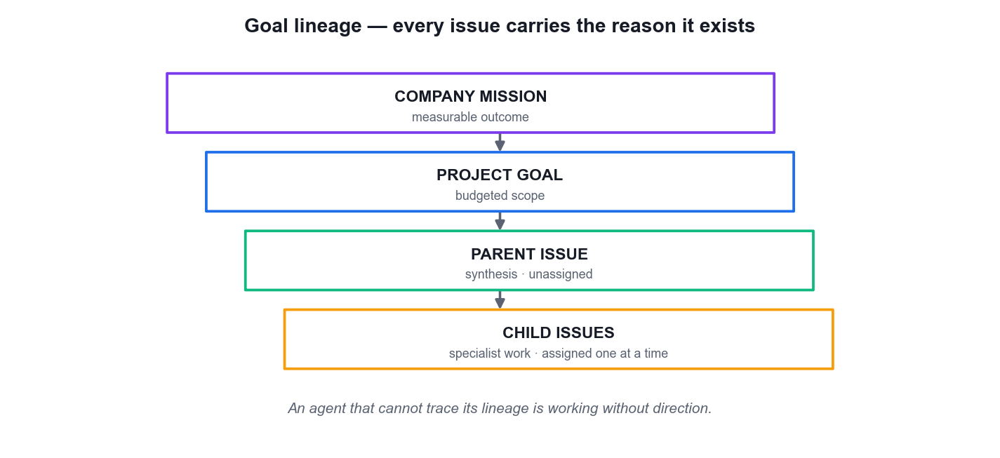
LO3 · THE AGENT SEES WHY, NOT ONLY WHAT
Goal Lineage — Every Issue Carries Its Reason
Mission
One measurable outcome defines why the company exists.
Project goal
A budgeted scope the agent reads at runtime.
Parent issue
The synthesis — created unassigned so it cannot wake early.
Child issues
Specialist work, assigned ONE AT A TIME.
Manage AI Agents with Paperclip (TGS-2023036646) · TGS-2023036646
© 2026 Tertiary Infotech Academy Pte Ltd
85

Slide 86
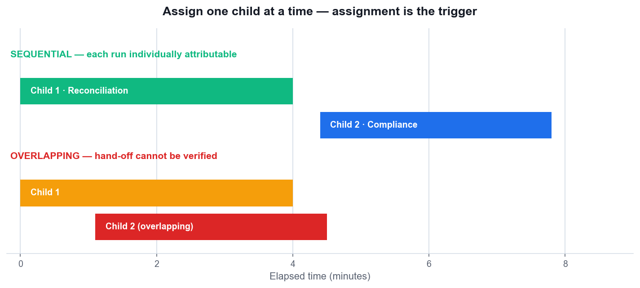
LO3 · WHY SEQUENCE MATTERS
Assign One Child at a Time
Assignment is the trigger
Creating an issue does not wake anyone — assigning it does.
Sequential = attributable
Non-overlapping runs let you tie each artifact to exactly one run.
Overlapping = unverifiable
If both ran at once you cannot prove the hand-off actually happened.
Bound every wait
An unbounded wait hides a failed adapter behind apparent patience.
Manage AI Agents with Paperclip (TGS-2023036646) · TGS-2023036646
© 2026 Tertiary Infotech Academy Pte Ltd
86

Slide 87
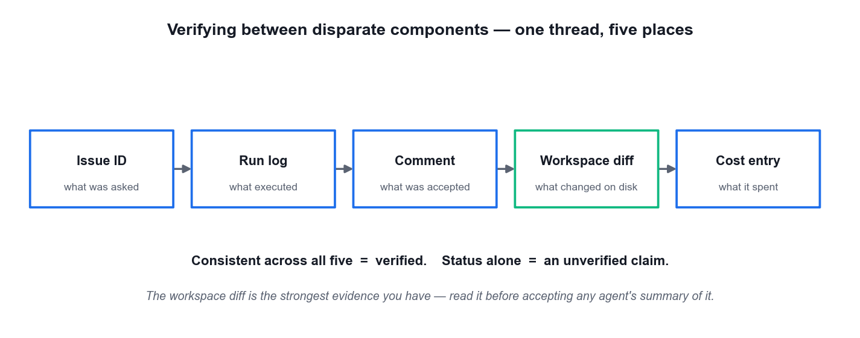
LO3 · WHAT 'VERIFIED' ACTUALLY MEANS
Verifying Between Disparate Components
Five places, one thread
Issue ID, run log, comment, workspace diff and cost entry must agree.
The diff is king
Read what actually changed on disk before accepting any agent's summary.
Status is not evidence
'Done' with no artifact and no diff is an unverified claim.
Name the evidence
An acceptance criterion states the artifact, its path and its fields.
Manage AI Agents with Paperclip (TGS-2023036646) · TGS-2023036646
© 2026 Tertiary Infotech Academy Pte Ltd
87

Slide 88
LO3 · ACCEPTING WORK
Hand-Off Acceptance — What You Are Actually Checking
Consumable without a question
The receiving agent can use the artifact without asking the producer anything.
Limitations stated
An agent that reports what it could NOT establish is more useful than one that quietly guesses.
1
2
Idempotent
One event should not create many outcomes — re-running must not duplicate the work.
Traceable
Every claim in the deliverable points back to a named source in the allowed inputs.
3
4
Accept artifacts and explicit limitations — never a status change on its own.
Manage AI Agents with Paperclip (TGS-2023036646) · TGS-2023036646
© 2026 Tertiary Infotech Academy Pte Ltd
88

Slide 89
LO3 · THE ASSESSMENT EXPECTS THESE BY NAME
The Seven Issue States
State
The documentation's own definition
backlog
The issue exists and has been identified, but no one is working on it yet.
todo
The issue is ready to start. An agent has been assigned and is waiting to check it out.
in_progress
An agent has checked out the issue and is actively working on it. Only ONE agent may hold this state at a time.
in_review
The agent has completed the work and moved the issue to review. It is waiting for sign-off.
done
TERMINAL. The work is complete.
blocked
The agent cannot move forward. Something is preventing progress.
cancelled
TERMINAL. The issue is no longer needed and will not be completed.
WHEN IT MATTERS Issues do not move backwards. A terminal issue is revived only through an explicit reopen — never by editing its status.
Manage AI Agents with Paperclip (TGS-2023036646) · TGS-2023036646
© 2026 Tertiary Infotech Academy Pte Ltd
89

Slide 90
LO3 · WITH BLOCKED AND CANCELLED AS DEPARTURES
The Normal Issue Path
1
2
3
4
5
▶
▶
▶
▶
backlog — identified, nobody working
todo — assigned, waiting to check out
in_progress — checked out, exclusive
in_review — done, awaiting sign-off
done — terminal
Manage AI Agents with Paperclip (TGS-2023036646) · TGS-2023036646
© 2026 Tertiary Infotech Academy Pte Ltd
90

Slide 91
LO3 · THE RULE THAT PREVENTS DOUBLE WORK
Checkout Discipline — Four Common Mistakes
Mistake
What to do instead
PATCHing status directly to in_progress
Never do this. Use the checkout mechanism — a direct status write bypasses the lock entirely.
Retrying after a 409 Conflict
Treat 409 as TERMINAL. Another agent holds the issue; retrying will not win the race.
Expecting a cancelled blocker to unblock its dependents
Cancelled blockers never auto-unblock dependents. Resolve the dependency explicitly.
Editing a done issue's status to reopen it
Terminal issues reopen only via an explicit reopen flag, not a status edit.
Writing to the whole board from one run
CROSS_ISSUE_INFLUENCE_LIMIT is 20 — one heartbeat may write to at most twenty other issues.
WHEN IT MATTERS Runs identify themselves with a run-id header. That is how a write is attributed to the execution that made it.
Manage AI Agents with Paperclip (TGS-2023036646) · TGS-2023036646
© 2026 Tertiary Infotech Academy Pte Ltd
91

Slide 92
LO3 · BETWEEN HEARTBEATS THE AGENT DOES NOT EXIST
The Five Heartbeat Triggers
Schedule / interval
The configured interval ticks — whether or not there is any work waiting.
Task assignment
An issue is assigned to the agent. THIS is what makes assignment the real trigger for work.
1
2
Comment mention
Someone @-mentions the agent in a comment on an issue.
Manual invoke
A human presses Run Heartbeat.
3
4
Approval resolution
An approval the agent was waiting on is finally decided.
Most people name three
The two people miss are approval resolution and the @-mention — and both explain 'why did it just wake?'
5
6
Heartbeat on interval is OFF by default — and that default is the right one.
Manage AI Agents with Paperclip (TGS-2023036646) · TGS-2023036646
© 2026 Tertiary Infotech Academy Pte Ltd
92

Slide 93
LO3 · TWO THINGS THAT LOOK THE SAME AND ARE NOT
Paused versus Heartbeat-Off
Condition
Wakes on interval
Wakes on assignment, comment, routine, on-demand
Heartbeat off
No
YES — the agent still responds to events
Paused
No
No — a paused agent wakes on nothing at all
Why it matters
An interval costs money on every tick, work or not
Event-driven waking costs nothing when nothing is happening
The recommendation
Interval OFF
Wake-on-demand ON. The interval is a floor, not a guarantee.
WHEN IT MATTERS A busy agent may run MORE often than its interval, because events trigger wakes independently of the clock.
Manage AI Agents with Paperclip (TGS-2023036646) · TGS-2023036646
© 2026 Tertiary Infotech Academy Pte Ltd
93

Slide 94
LO3 · THE HIGHEST-LEVERAGE WRITING SKILL IN THE COURSE
Acceptance Criteria — Activity versus Evidence
Fails — describes activity
Works — names evidence
The research is done.
workspace/research-analyst/research.md exists and contains claim, source, date accessed and confidence for every claim.
Reconcile the control accounts.
reconciliation.md lists every control account with ledger balance, statement balance and variance.
Review for compliance.
exceptions.md lists each variance above SGD 500 with a stated cause and a recommended treatment.
WHEN IT MATTERS The test: could a stranger with no knowledge of the conversation look at the workspace and say yes or no? If not, the criterion is not finished.
Manage AI Agents with Paperclip (TGS-2023036646) · TGS-2023036646
© 2026 Tertiary Infotech Academy Pte Ltd
94

Slide 95
LO3 · VERIFYING BETWEEN DISPARATE COMPONENTS
The Evidence Chain — One Thread, Five Places
1
2
3
4
5
Issue ID
Run log
Comment
Workspace diff
Cost entry
What was asked, under which lineage
What actually executed, and whether it errored
What was accepted, by whom, on what basis
What changed on disk — the strongest evidence
What it spent, and whether that is plausible
STATUS IS NOT EVIDENCE
An issue marked done with no linked artifact and no diff is an unverified claim, however confident the agent's summary sounds.
Manage AI Agents with Paperclip (TGS-2023036646) · TGS-2023036646
© 2026 Tertiary Infotech Academy Pte Ltd
95

Slide 96
LO3 · A REVIEW WORKFLOW ENFORCED BY THE PLATFORM
Execution Policy Parameters
Parameter
Value
What it does
maxReviewRounds
Default 3 · range 1–50
Caps how many times work can bounce back. A null value means the server default of 3.
approvalsNeeded
Fixed at 1
One approval advances the stage. This is not configurable.
changesRequestedCount
Counts review rounds
Escalates to a named reviewer once the cap is reached.
Comment-required backstop
retry_queued → retry_exhausted
The fallback path when a required comment never arrives.
WHEN IT MATTERS Once a reviewer is escalated to, only that reviewer may advance the stage. A 422 'only the escalated reviewer' error is the policy working, not a bug.
Manage AI Agents with Paperclip (TGS-2023036646) · TGS-2023036646
© 2026 Tertiary Infotech Academy Pte Ltd
96

Slide 97
LO3 · SEQUENCE IS A CONTROL, NOT A PREFERENCE
Decomposition and Assignment Discipline
Create everything COLD
Parent synthesis issue and all children UNASSIGNED — assignment is a heartbeat trigger.
Why unassigned matters
An issue created with an assignee wakes an agent before you have written the acceptance criteria or checked the caps.
1
2
Assign ONE child at a time
Sequential runs are individually attributable; overlapping runs are not.
The proof you lose
If two specialists ran simultaneously you cannot demonstrate the second consumed the first's output.
3
4
The parent waits
The synthesis issue stays unassigned until every child has produced its artifact.
Bound every wait
An unbounded wait hides a failed adapter behind apparent patience.
5
6
Creating an issue does not wake anyone. Assigning it does.
Manage AI Agents with Paperclip (TGS-2023036646) · TGS-2023036646
© 2026 Tertiary Infotech Academy Pte Ltd
97

Slide 98
LO3 · LINEAGE IS FOUR LEVELS, NOT ONE SENTENCE
Goal Lineage — What Each Level Supplies
Level
What it carries
What breaks if it is missing
Company mission
The measurable outcome the company exists for
Agents optimise a local goal that does not serve the business.
Project goal
A budgeted scope the agent reads at runtime
Work has no boundary and no lifetime cap.
Parent issue
The synthesis that consumes every child's output
Nobody assembles the pieces; you do it by hand.
Child issue
One specialist transformation with named evidence
The instruction becomes a list of unrelated responsibilities.
WHEN IT MATTERS If you re-explain the goal in every issue body, your lineage is broken — and you are paying for the same context repeatedly.
Manage AI Agents with Paperclip (TGS-2023036646) · TGS-2023036646
© 2026 Tertiary Infotech Academy Pte Ltd
98

Slide 99
LO3 · WHAT YOU ARE ACTUALLY CHECKING
Hand-Off Acceptance Tests
Consumable without a question
The receiving agent can use the artifact without asking the producer anything at all.
If the receiver must ask
The output schema in the PRODUCER's instruction was under-specified. Fix the contract, not the artifact.
1
2
Limitations are stated
An agent that reports what it could NOT establish is more useful than one that quietly guesses.
Idempotent
One event should not create many outcomes — re-running must not duplicate the work.
3
4
Traceable
Every claim points back to a named source inside the allowed inputs.
The diff is read first
An agent describing its own work is a witness with an interest in the verdict.
5
6
Accept artifacts and explicit limitations — never a status change on its own.
Manage AI Agents with Paperclip (TGS-2023036646) · TGS-2023036646
© 2026 Tertiary Infotech Academy Pte Ltd
99

Slide 100
LO3 · PROJECTS HOLD GOALS, ISSUES AND A LIFETIME BUDGET
Projects — Lifecycle and the Lifetime Cap
Project state
Meaning
Operator action
backlog
Identified, not yet scheduled
Write the goal before you plan it.
planned
Scoped and budgeted, not started
Confirm the LIFETIME budget cap now — it is distinct from monthly caps.
in_progress
Issues are being worked
Watch the utilisation bar and the run cadence.
completed
The goal has been met
Close the audit map before you archive.
cancelled
Abandoned
Record why. A cancelled project is still evidence.
WHEN IT MATTERS Company and agent budgets are MONTHLY. The project budget is a LIFETIME cap for an execution-bound project — a different period, not a different ring.
Manage AI Agents with Paperclip (TGS-2023036646) · TGS-2023036646
© 2026 Tertiary Infotech Academy Pte Ltd
100

Slide 101
WHAT YOU'LL DO
Hands-On Labs — Developing Intelligent Multi-Agent Systems
Lab 4
Lab 5
—
• Translate the Ledgerly Mission into Assigned Issues and Hand-Offs (Accounting)
• Ledgerly Accounting (Accounting)
• Verify NorthPoint Routines and Layered Budget Controls (Stock Trading Research)
• NorthPoint Trading Research (Stock Trading — research only)
• —
Manage AI Agents with Paperclip (TGS-2023036646) · TGS-2023036646
© 2026 Tertiary Infotech Academy Pte Ltd
101

Slide 102
LAB 4 · HANDS-ON
Translate the Ledgerly Mission into Assigned Issues and Hand-Offs (Accounting)
SIMULATED COMPANY · Ledgerly Accounting (Accounting)
You turn the Ledgerly Accounting mission into actual work. You create a budgeted month-end close project, then a PARENT synthesis issue and two specialist CHILD issues — all created UNASSIGNED, so that creating work cannot accidentally wake an agent. Only after every acceptance criterion names its evidence do you assign one child at a time. This is the core discipline of the topic: assignment is the trigger, and sequential assignment is what makes each run individually verifiable.
YOU'LL BUILD
MAPS TO
A capped Ledgerly close project with an unassigned parent issue, two sequentially completed specialist children, clean workspace manifests, and an evidence record linking issue IDs, run IDs, comments, statuses and artifact paths.
LO3: Decompose a mission into a parent and specialist child issues, run the specialists sequentially and verify each hand-off against acceptance evidence.
Tools: Paperclip Projects, Budgets, Issues, Agents and Runs; approved adapter runtime; Git; Markdown workspaces
Full step-by-step procedure: Learner Guide, Lab 4 · labs/ folder
Manage AI Agents with Paperclip (TGS-2023036646) · TGS-2023036646
© 2026 Tertiary Infotech Academy Pte Ltd
102

Slide 103
LAB 4 · PROCESS MAP
How Lab 4 Runs
1
2
3
4
5
Create the close project
Parent issue, unassigned
Two child issues
Assign child 1 only
Accept, then assign child 2
its own budget cap
creation must not wake anyone
acceptance names the evidence
assignment is the trigger
sequential and attributable
THE POINT
LO3: Decompose a mission into a parent and specialist child issues, run the specialists sequentially and verify each hand-off against acceptance evidence.
Manage AI Agents with Paperclip (TGS-2023036646) · TGS-2023036646
© 2026 Tertiary Infotech Academy Pte Ltd
103

Slide 104
LAB 4 · VERIFY
Translate the Ledgerly Mission into Assigned Issues and Hand-Offs (Accounting)
✅ Expected result
The Ledgerly project shows a saved cap above actual spend; the parent issue is still open and unassigned; both children are Done with a linked artifact and a recorded run ID; the two specialists ran SEQUENTIALLY (non-overlapping run timestamps); and the exceptions file demonstrably references the reconciliation figures.
IF IT DOESN'T WORK
Both specialists wake at the same time
The child artifact exists but is missing fields
The parent issue wakes unexpectedly
A child was assigned before the previous one was accepted. Pause the second agent, let the first run settle, then re-assign so the runs are sequential.
The acceptance criterion was written as an activity, not as evidence. Rewrite it naming the required fields and re-run — do not hand-edit the agent's artifact.
It was assigned during creation. Clear the assignee; the parent stays unassigned until both children are accepted (that is Lab 6).
Manage AI Agents with Paperclip (TGS-2023036646) · TGS-2023036646
© 2026 Tertiary Infotech Academy Pte Ltd
104

Slide 105
LAB 4 · TROUBLESHOOTING
Translate the Ledgerly Mission into Assigned Issues and Hand-Offs (Accounting)
⚠ Both specialists wake at the same time
A child was assigned before the previous one was accepted. Pause the second agent, let the first run settle, then re-assign so the runs are sequential.
⚠ The child artifact exists but is missing fields
The acceptance criterion was written as an activity, not as evidence. Rewrite it naming the required fields and re-run — do not hand-edit the agent's artifact.
⚠ The parent issue wakes unexpectedly
It was assigned during creation. Clear the assignee; the parent stays unassigned until both children are accepted (that is Lab 6).
CHALLENGE
REFLECTION
Add a third child issue whose acceptance criterion deliberately names an artifact the previous child never produces, and record precisely how the failure surfaces in the run log.
Why does creating every issue unassigned change the risk profile of a multi-agent company, compared with assigning at creation time?
Manage AI Agents with Paperclip (TGS-2023036646) · TGS-2023036646
© 2026 Tertiary Infotech Academy Pte Ltd
105

Slide 106
LAB 5 · HANDS-ON
Verify NorthPoint Routines and Layered Budget Controls (Stock Trading Research)
SIMULATED COMPANY · NorthPoint Trading Research (Stock Trading — research only)
NorthPoint Trading Research needs a daily pre-market brief — which makes it the right place to learn routines. You create the readiness routine PAUSED, add an explicit cron trigger with an IANA timezone, prove the routine once by hand, and leave it paused afterwards. You then verify all three budget layers against actual recorded spend. The rule the lab teaches: automation earns the schedule only after a human has watched it succeed once. This is research only — the company never places or recommends a trade.
YOU'LL BUILD
MAPS TO
A paused NorthPoint readiness routine with a saved 07:00 Asia/Singapore trigger, exactly one reviewed manual run, and a control table proving company, project and agent budget layers all remain above recorded spend.
LO3: Test a scheduled routine and verify that every budget layer holds, using one bounded manual run before automation is allowed to own the schedule.
Tools: Paperclip Routines, Costs and Budgets, Agent Budget tabs, Project settings, Activity
Full step-by-step procedure: Learner Guide, Lab 5 · labs/ folder
Manage AI Agents with Paperclip (TGS-2023036646) · TGS-2023036646
© 2026 Tertiary Infotech Academy Pte Ltd
106

Slide 107
LAB 5 · PROCESS MAP
How Lab 5 Runs
1
2
3
4
5
Create NorthPoint
Create the routine PAUSED
Add the cron trigger
Run once, bounded
Check every budget layer
research only — never a trade
unproven automation stays off
0 7 * * * with Asia/Singapore
the human review earns the schedule
company, project and agent
THE POINT
LO3: Test a scheduled routine and verify that every budget layer holds, using one bounded manual run before automation is allowed to own the schedule.
Manage AI Agents with Paperclip (TGS-2023036646) · TGS-2023036646
© 2026 Tertiary Infotech Academy Pte Ltd
107

Slide 108
LAB 5 · VERIFY
Verify NorthPoint Routines and Layered Budget Controls (Stock Trading Research)
✅ Expected result
The routine carries an explicit 0 7 * * * Asia/Singapore trigger, has exactly ONE successful reviewed manual run, and finishes PAUSED; the brief exists and cites only the synthetic data with limitations stated and no trade recommendation; and the control table shows all three budget layers above recorded spend.
IF IT DOESN'T WORK
The routine fires unexpectedly
The cost shows as zero
The timezone reverts or the schedule fires an hour out
It was left active after the manual run. Pause it, then check the activity log for any additional runs and record them — do not delete the evidence.
The run may have failed before invoking the runtime. Read the run log for an adapter error rather than assuming the work was free.
The trigger was saved without an explicit IANA timezone and inherited the host's. Re-save the trigger with Asia/Singapore stated explicitly.
Manage AI Agents with Paperclip (TGS-2023036646) · TGS-2023036646
© 2026 Tertiary Infotech Academy Pte Ltd
108

Slide 109
LAB 5 · TROUBLESHOOTING
Verify NorthPoint Routines and Layered Budget Controls (Stock Trading Research)
⚠ The routine fires unexpectedly
It was left active after the manual run. Pause it, then check the activity log for any additional runs and record them — do not delete the evidence.
⚠ The cost shows as zero
The run may have failed before invoking the runtime. Read the run log for an adapter error rather than assuming the work was free.
⚠ The timezone reverts or the schedule fires an hour out
The trigger was saved without an explicit IANA timezone and inherited the host's. Re-save the trigger with Asia/Singapore stated explicitly.
CHALLENGE
REFLECTION
Lower the Market Data Analyst cap below the recorded run cost, run the routine once more, and record exactly which layer stops the run and where it is reported.
Why must a routine be proved by one bounded manual run before the schedule is allowed to own it?
Manage AI Agents with Paperclip (TGS-2023036646) · TGS-2023036646
© 2026 Tertiary Infotech Academy Pte Ltd
109

Slide 110
TOPIC RECAP
Recap — Developing Intelligent Multi-Agent Systems
• You can now: LO3: Decompose a mission into a parent and specialist child issues, run the specialists sequentially and verify each hand-off against acceptance evidence.
• You can now: LO3: Test a scheduled routine and verify that every budget layer holds, using one bounded manual run before automation is allowed to own the schedule.
• Projects hold goals and issues and supply the context an agent reads at runtime, so tasks carry full goal ancestry — the agent sees why, not only what.
• Goal lineage flows downward: company mission → project goal → parent issue → child issue. An agent that cannot trace its lineage is working without direction.
• Issues move through seven states — backlog, todo, in_progress, in_review, done, plus blocked and cancelled. done and cancelled are TERMINAL: issues do not move backwards.
Manage AI Agents with Paperclip (TGS-2023036646) · TGS-2023036646
© 2026 Tertiary Infotech Academy Pte Ltd
110

Slide 111
04
TOPIC 04
Deploying and Managing AI Agents
Routines and schedules · layered budgets · approvals and audit · operator intervention · deployment, portability and troubleshooting
Manage AI Agents with Paperclip (TGS-2023036646) · TGS-2023036646
© 2026 Tertiary Infotech Academy Pte Ltd
111

Slide 112
TOPIC WEIGHTING 25%
Key Concepts — Deploying and Managing AI Agents
A routine is recurring work triggered by cron, webhook or API. Create it paused, prove it once by hand, and only then let the schedule own it.
A schedule trigger is explicit — 30 16 * * * with an IANA timezone such as Asia/Singapore. An implicit timezone is a production incident waiting to happen.
1
2
Budgets have three scopes enforced in PARALLEL: company (monthly), agent (monthly) and project (lifetime). An agent can be paused by its own cap even when the company has budget left.
Enforcement is a two-stage circuit breaker at exact thresholds: 80% utilisation records a warning and the agent keeps running; 100% pauses the agent automatically with pauseReason = budget. Enforcement happens at checkout, not at billing.
3
4
Treat the budget as a two-stage circuit breaker — warn, then stop — and record the baseline spend and expected run frequency before you rely on it.
5
Manage AI Agents with Paperclip (TGS-2023036646) · TGS-2023036646
© 2026 Tertiary Infotech Academy Pte Ltd
112

Slide 113
TOPIC WEIGHTING 25%
Key Concepts — Deploying and Managing AI Agents (continued)
Cost is tracked at token level by provider, model, agent and project, which is what makes the per-agent cap meaningful rather than notional.
Approvals come in three types — CEO Strategy, Hire Agent and Budget Override — and you have three responses: approve, reject, or request revision. Approvals never expire on their own, so a silent company is often an unattended approval queue.
1
2
The activity log is a durable record of mutations, heartbeats, cost events and approvals — the audit loop closes when the whole operation reconstructs from it.
Use the least irreversible control first: inspect, pause, reassign, then terminate. Pause and heartbeat-off differ: heartbeat-off still wakes on assignment, comment, routine and on-demand; a paused agent wakes on nothing.
3
4
Deployment modes are local_trusted (the default, no login), authenticated+private and authenticated+public, set with paperclipai configure --section server.
5
Manage AI Agents with Paperclip (TGS-2023036646) · TGS-2023036646
© 2026 Tertiary Infotech Academy Pte Ltd
113

Slide 114
TOPIC WEIGHTING 25%
Key Concepts — Deploying and Managing AI Agents (continued)
A hosted deployment REQUIRES PAPERCLIP_AGENT_JWT_SECRET and DATABASE_URL; PAPERCLIP_TOOL_ACTION_SIGNING_SECRET is separately documented as required with no fallback for TOOL-ACTION approvals.
Portability means an entire company exports and imports with secrets scrubbed and collisions handled — the org chart is data, not a hand-built configuration.
1
2
Troubleshooting is a discipline: reproduce, isolate the layer, change one setting, re-verify with evidence, and record what the fix actually proved.
3
Manage AI Agents with Paperclip (TGS-2023036646) · TGS-2023036646
© 2026 Tertiary Infotech Academy Pte Ltd
114

Slide 115
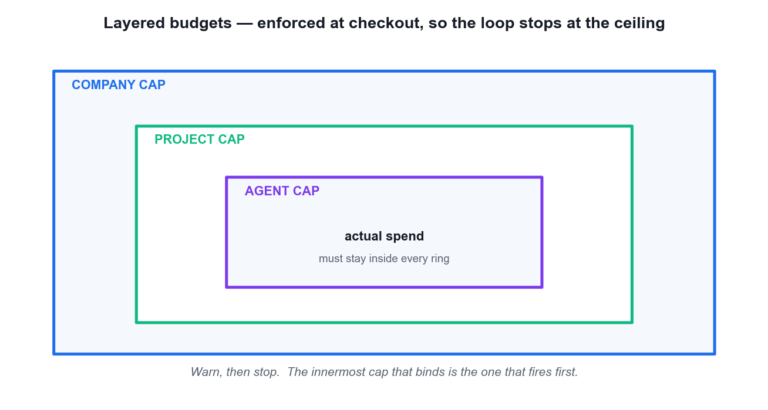
LO4 · COST CONTROL AS A CIRCUIT BREAKER
Layered Budgets — Warn, Then Stop
Three rings
Company, project and agent — the innermost cap that binds fires first.
Enforced at checkout
Not at billing. The loop stops at the ceiling.
Baseline first
Record current spend and expected run frequency before you rely on a cap.
Token-level costing
Tracked by provider, model, agent and project — which is what makes the cap meaningful.
Manage AI Agents with Paperclip (TGS-2023036646) · TGS-2023036646
© 2026 Tertiary Infotech Academy Pte Ltd
115

Slide 116
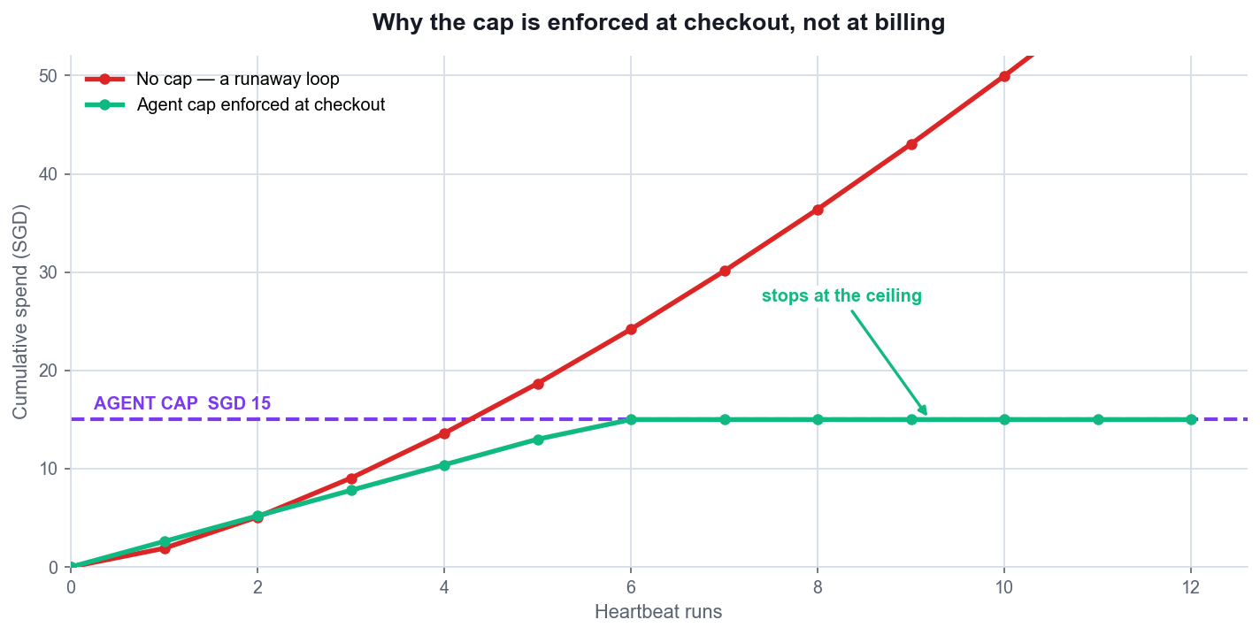
LO4 · THE ENGINEERING ARGUMENT
Why the Cap Is Enforced at Checkout
Without a cap
A runaway loop keeps spending until someone notices the invoice.
With a cap
Spend flattens at the ceiling and the agent simply stops.
The cap is a control
Not a budget estimate — it is the thing that makes unattended operation safe.
Set it below the pain
A cap you would be unhappy to actually pay is set too high.
Manage AI Agents with Paperclip (TGS-2023036646) · TGS-2023036646
© 2026 Tertiary Infotech Academy Pte Ltd
116

Slide 117
LO4 · SCHEDULED WORK
Routines — Automation Earns the Schedule
Create it PAUSED
A routine live before it has ever succeeded is unreviewed scheduled spend.
State the trigger explicitly
30 16 * * * WITH an IANA timezone such as Asia/Singapore.
1
2
Prove it once by hand
One bounded manual run, reviewed by a human.
Leave it paused
Until you have read the generated issue, the run and the cost.
3
4
Name the artifact
The routine body must state what file it produces, or the run is unverifiable.
Watch for concurrency
One event should not create many outcomes.
5
6
An implicit timezone is a production incident waiting to happen.
Manage AI Agents with Paperclip (TGS-2023036646) · TGS-2023036646
© 2026 Tertiary Infotech Academy Pte Ltd
117

Slide 118
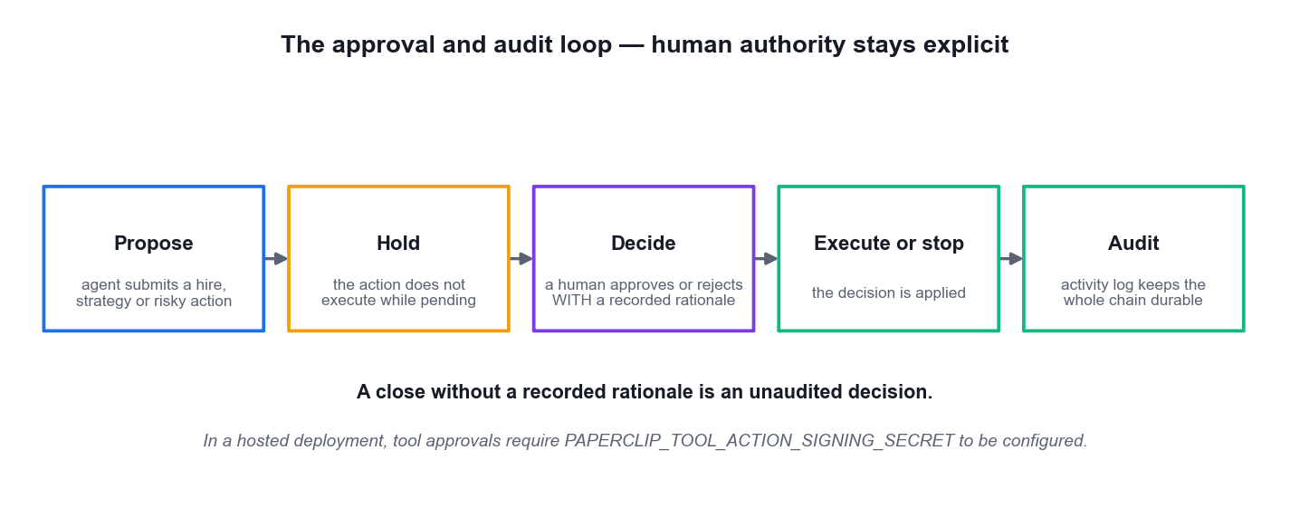
LO4 · HUMAN AUTHORITY STAYS EXPLICIT
The Approval and Audit Loop
Propose, then hold
The governed action does not execute while it is pending.
A human decides
With a RECORDED rationale — that sentence is the audit.
The log is durable
Mutations, heartbeats, cost events and approvals all land in Activity.
The loop closes
When the whole operation can be reconstructed from the log alone.
Manage AI Agents with Paperclip (TGS-2023036646) · TGS-2023036646
© 2026 Tertiary Infotech Academy Pte Ltd
118

Slide 119
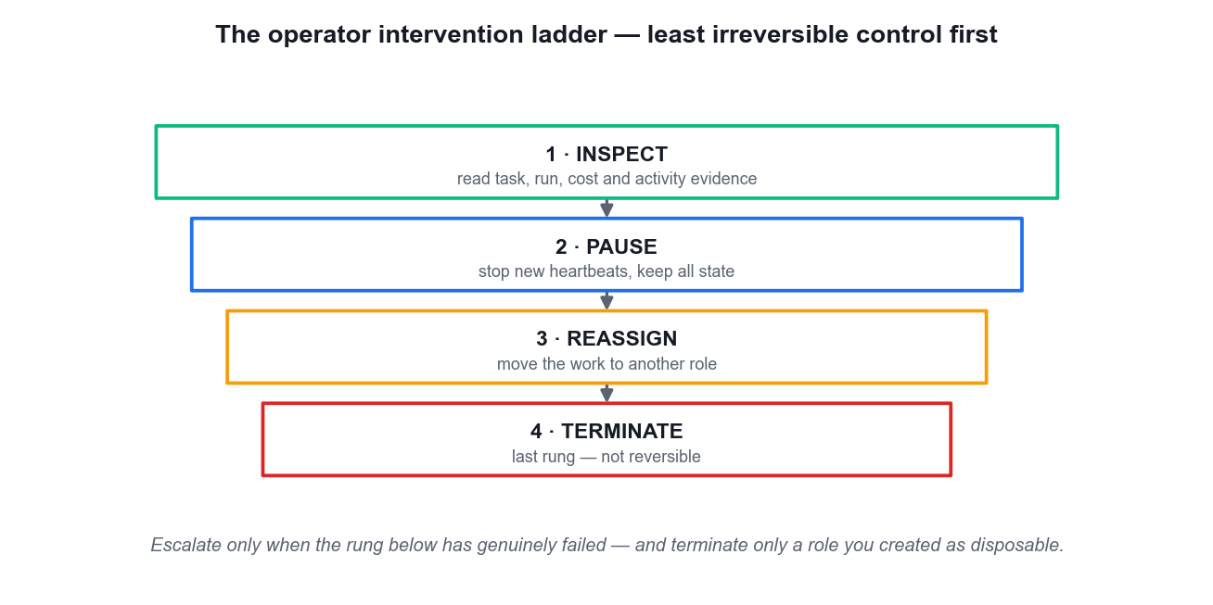
LO4 · USE THE LEAST IRREVERSIBLE CONTROL
The Operator Intervention Ladder
Inspect
Read task, run, cost and activity evidence BEFORE acting.
Pause
Stop new heartbeats while keeping all state.
Reassign
Move the work to another role.
Terminate
The last rung — and it is not reversible.
Manage AI Agents with Paperclip (TGS-2023036646) · TGS-2023036646
© 2026 Tertiary Infotech Academy Pte Ltd
119

Slide 120
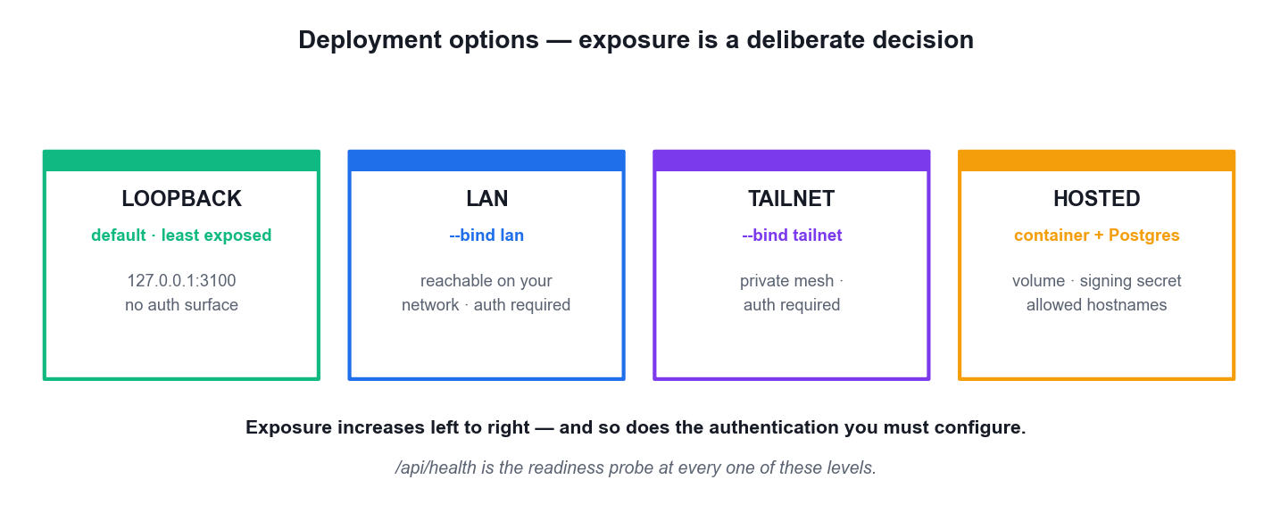
LO4 · TAKING IT BEYOND THE LAPTOP
Deployment Options — Exposure Is a Decision
Loopback
The default and least exposed — trusted local only.
LAN / tailnet
--bind lan or --bind tailnet widen reach and REQUIRE authentication.
Hosted
Container plus external PostgreSQL, a persistent volume, a signing secret and an allowed-hostnames list.
Portability
A whole company exports and imports with secrets scrubbed and collisions re-mapped.
Manage AI Agents with Paperclip (TGS-2023036646) · TGS-2023036646
© 2026 Tertiary Infotech Academy Pte Ltd
120

Slide 121
LO4 · THE MOST EXPENSIVE MISUNDERSTANDING IN THE COURSE
The Three Budget Scopes — Parallel, Not Nested
Scope
Period
Applies to
Company budget
Monthly
The total ceiling for the entire company.
Per-agent budget
Monthly
One individual agent's ceiling.
Project budget
Lifetime
An execution-bound project, for the whole of its life.
The consequence
They are independent
An agent can be paused by its OWN budget limit even if the company has remaining budget.
WHEN IT MATTERS Do not picture nested rings where the outer one always binds first. Picture three separate trip switches, any one of which can fire.
Manage AI Agents with Paperclip (TGS-2023036646) · TGS-2023036646
© 2026 Tertiary Infotech Academy Pte Ltd
121

Slide 122
LO4 · A TWO-STAGE CIRCUIT BREAKER
Thresholds and Utilisation Colours
80% utilisation
A WARNING is recorded so you can intervene. The agent CONTINUES running — nothing stops.
100% utilisation
The agent is automatically PAUSED. No further heartbeats fire, and pauseReason is set to budget.
1
2
Green · below 70%
Read the utilisation bar for company health at a glance.
Yellow · 70 to 90%
Look closer. Something is either busier or more expensive than you planned.
3
4
Red · above 90%
Intervene now — the hard stop at 100% is close.
Enforced AT CHECKOUT
Before the work runs, not when the invoice arrives. That is what makes unattended operation safe.
5
6
A cap you would be unhappy to actually pay is set too high.
Manage AI Agents with Paperclip (TGS-2023036646) · TGS-2023036646
© 2026 Tertiary Infotech Academy Pte Ltd
122

Slide 123
LO4 · TOKEN-LEVEL COSTING IS WHAT MAKES A CAP MEANINGFUL
Inference Spend versus Finance Events
Inference spend
Finance events
What it records
Per-request model cost
Subscriptions, invoices, credits, refunds, adjustments
Tracked by
Provider, model, agent and project
The commercial relationship, not the run
Drives the cap
YES — this is what utilisation measures
No — a credit does not raise an agent's ceiling
The mistake
Reading one and thinking you have seen the other
The Costs page separates them deliberately
WHEN IT MATTERS Baseline current spend and expected run frequency BEFORE you rely on a cap. A ceiling you have not calibrated is a guess with a number on it.
Manage AI Agents with Paperclip (TGS-2023036646) · TGS-2023036646
© 2026 Tertiary Infotech Academy Pte Ltd
123

Slide 124
LO4 · WHERE HUMAN AUTHORITY IS MADE EXPLICIT
The Three Approval Types
CEO Strategy
Raised when the CEO produces a strategic plan after its first heartbeat. The CEO cannot move tasks to in-progress until you approve it.
Hire Agent
Raised when an agent — usually the CEO or a manager — proposes a subordinate.
1
2
The hire payload
Name, role, capabilities, adapter configuration, monthly budget and reporting line. Read every field before approving.
Budget Override
Raised when a budget policy hits a hard stop and someone asks to proceed anyway. This is the one to slow down on.
3
4
Approvals never expire
An agent waiting on a pending approval pauses indefinitely. A silent company is very often an unattended queue.
The board override
The board may pause any agent and resume any paused agent, bypassing the approval flow entirely.
5
6
Manage AI Agents with Paperclip (TGS-2023036646) · TGS-2023036646
© 2026 Tertiary Infotech Academy Pte Ltd
124

Slide 125
LO4 · THE THIRD RESPONSE IS THE USEFUL ONE
The Three Approval Responses
APPROVE
The action proceeds. For a hire, the agent is created, configured and queued to wake automatically.
REJECT
The action is denied. The requesting agent is notified and will not retry unless instructed.
1
2
REQUEST REVISION
You are not approving as-is, but you are not saying no. The agent revises and resubmits. This is the one people forget exists.
The state machine
pending goes to approved, rejected, or revision_requested — then resubmitted, and back to pending.
3
4
RECORD THE RATIONALE
One sentence explaining why is the difference between a decision and an unaudited event.
Months later
The rationale is the only thing that will tell you — or a regulator — what you were thinking.
5
6
Manage AI Agents with Paperclip (TGS-2023036646) · TGS-2023036646
© 2026 Tertiary Infotech Academy Pte Ltd
125

Slide 126
LO4 · AUTOMATION EARNS THE SCHEDULE
The Routine Safety Sequence
1
2
3
4
5
Create it PAUSED
State the trigger
Name the artifact
Run once by hand
Only then unpause
Never live before it has ever succeeded
Cron expression AND an IANA timezone
Or the run succeeds but is unverifiable
Bounded wait; read issue, run and cost
The schedule now owns reviewed work
WHY THE TIMEZONE IS NOT A FORMALITY
A cron expression without a timezone runs in whatever zone the host happens to be in — fine until the host moves, the clock changes, or someone deploys to another region. Write Asia/Singapore explicitly.
Manage AI Agents with Paperclip (TGS-2023036646) · TGS-2023036646
© 2026 Tertiary Infotech Academy Pte Ltd
126

Slide 127
LO4 · ONLY ONE STATUS ACTUALLY FIRES
Routine States and Defaults
active
The only status that actually fires. Everything else is dormant.
paused
Created here, and it stays here until you have proved it by hand.
1
2
archived
Retired. Kept for the audit trail, not for execution.
draft · running · succeeded · failed
List-view badges, not statuses — do not confuse a badge with the routine's real state.
3
4
Five-minute granularity
The routine editor snaps minutes to five-minute increments. Plan the schedule around that.
Coalesce if active, skip missed
The concurrency default: a routine already running will not start a second copy, and a missed window is skipped.
5
6
A routine stuck in running with nothing happening usually means a lost process.
Manage AI Agents with Paperclip (TGS-2023036646) · TGS-2023036646
© 2026 Tertiary Infotech Academy Pte Ltd
127

Slide 128
LO4 · ESCALATE ONLY WHEN THE RUNG BELOW HAS FAILED
The Intervention Ladder — Least Irreversible First
Rung
Action
Reversible?
Use when
1
INSPECT — read task, run, cost and activity evidence
Yes — nothing changes
Always. Never act before you have looked.
2
PAUSE — stop new heartbeats, keep all state
Yes
The agent is doing something wrong and must stop now.
3
REASSIGN — move the work to another role
Yes
The work is valid but this agent is the wrong owner.
4
TERMINATE — retire the agent
NO
The role should not exist at all. Last resort only.
WHEN IT MATTERS Practise Terminate only on a role you deliberately created as disposable — never as a first response to a misbehaving production agent.
Manage AI Agents with Paperclip (TGS-2023036646) · TGS-2023036646
© 2026 Tertiary Infotech Academy Pte Ltd
128

Slide 129
LO4 · FOUR ROLES, AN UNSET STATE, 21 PERMISSION KEYS
RBAC — Company Roles and Their Grants
Role
Description
Implicit grants
Owner
The people who run the company
All eight — agents, skills, environments, users, tasks and joins
Admin
Trusted operators who onboard people and agents
As Owner, MINUS users:manage_permissions
Operator
Hands-on members who help run the work
tasks:assign
Viewer
Read-only observers
None
Unset
No implicit grants at all
Hand-picked explicit grants only — the tightest configuration available
WHEN IT MATTERS Owner's eight: agents:create, agents:configure, skills:create, environments:manage, users:invite, users:manage_permissions, tasks:assign, joins:approve. An explicit grant PERSISTS across a role change, and there is NO DENY LAYER — you cannot subtract a permission.
Manage AI Agents with Paperclip (TGS-2023036646) · TGS-2023036646
© 2026 Tertiary Infotech Academy Pte Ltd
129

Slide 130
LO4 · THREE MODES, THREE LEVELS OF EXPOSURE
Deployment Modes — Exposure Is a Decision
Mode
Login
Use it when
local_trusted (the default)
No login required
A single operator on their own machine. This is the mode used throughout this course.
authenticated + private
Login required, not publicly reachable
A small team on a trusted network or a private mesh.
authenticated + public
Login required, publicly reachable
A hosted deployment. Requires the most care: real auth, real secrets, real exposure.
WHEN IT MATTERS Set with configure --section server, or the PAPERCLIP_DEPLOYMENT_MODE environment variable. You inherit the default only if you never decide.
Manage AI Agents with Paperclip (TGS-2023036646) · TGS-2023036646
© 2026 Tertiary Infotech Academy Pte Ltd
130

Slide 131
LO4 · TWO ARE MARKED REQUIRED; A THIRD HAS NO FALLBACK
Environment Variables You Cannot Skip
PAPERCLIP_AGENT_JWT_SECRET
Signs agent tokens. REQUIRED — and it doubles as the fallback for the auth secret.
DATABASE_URL
The PostgreSQL connection string. REQUIRED.
1
2
TOOL_ACTION_SIGNING_SECRET
The PAPERCLIP_ prefixed variable that signs tool-action approvals. Documented as required, with NO fallback.
PAPERCLIP_ALLOWED_HOSTNAMES
The hostnames the server will answer for. Add your custom domain here.
3
4
PAPERCLIP_TELEMETRY_DISABLED
Set to 1 to disable telemetry. DO_NOT_TRACK works the same way.
Roughly seventy in total
Across nine categories. You do not need to memorise them — you do need to know which are required.
5
6
Manage AI Agents with Paperclip (TGS-2023036646) · TGS-2023036646
© 2026 Tertiary Infotech Academy Pte Ltd
131

Slide 132
LO4 · CONCRETELY, WHAT AN AUDITOR WOULD ASK YOU FOR
The Mission-to-Evidence Audit Map
Mission claim
One row per claim the company makes about what it achieved.
Issue
Which unit of work was supposed to produce it, and under which lineage.
1
2
Run
Which execution actually ran, and whether it errored.
Artifact
The file on disk, at a named path, with the fields you specified.
3
4
Cost
What it spent — and whether that is plausible for the work claimed.
Approval
The human decision, with its recorded rationale.
5
6
The loop closes when the whole operation reconstructs from the log alone.
Manage AI Agents with Paperclip (TGS-2023036646) · TGS-2023036646
© 2026 Tertiary Infotech Academy Pte Ltd
132

Slide 133
LO4 · ACTIVITY IS WHAT MAKES EVERYTHING ELSE DEFENSIBLE
Reading the Activity Log for Gaps
What you see
What it usually means
What to do
A steady, ordered sequence of runs
The audit loop is closed
Nothing. This is the state you are working towards.
A workspace change with no run
Work was done OUTSIDE a run — typically hand-edited
Record it honestly. The gap is itself an audit finding.
Long silence, no runs and no spend
An unattended approval queue
Open Approvals first. Approvals never expire on their own.
An agent stopped mid-work
The budget hard stop at 100%
Check utilisation and pauseReason. Raise the cap deliberately, or let it stop.
WHEN IT MATTERS Concealing a gap is far worse than having one. An honest note explaining a hand-edit costs you nothing; a silent gap costs you the whole audit.
Manage AI Agents with Paperclip (TGS-2023036646) · TGS-2023036646
© 2026 Tertiary Infotech Academy Pte Ltd
133

Slide 134
LO4 · WHERE THE MONEY ACTUALLY GOES
Cost Engineering Levers
Turn the interval OFF
It is off by default. An interval wakes the agent whether or not there is work, and each wake costs money.
Split the instruction files
Only HEARTBEAT.md is needed on every wake. Move occasional material out of the per-run path.
1
2
Use skills, not bigger prompts
Ten skills does not mean ten skills loaded per heartbeat — the agent loads only what it decides is relevant.
Cap at the agent, not just the company
The scopes are parallel, so the agent cap is what stops one runaway role.
3
4
Read the adapter defaults
300 turns per run and a four-hour sandbox timeout are large numbers to leave unexamined.
Keep lineage intact
Re-explaining the goal in every issue body means paying for the same context over and over.
5
6
Every lever here reduces tokens per run — which is the only cost that compounds.
Manage AI Agents with Paperclip (TGS-2023036646) · TGS-2023036646
© 2026 Tertiary Infotech Academy Pte Ltd
134

Slide 135
LO4 · MOVING A WHOLE COMPANY
Portability — A Company Is Data, Not a Craft Object
Export the whole company
Org chart, projects, issues, routines and configuration move together as one unit.
Secrets are scrubbed
Credentials do not travel in the export. They are re-provisioned at the destination.
1
2
Collisions are re-mapped
Identifier clashes at the destination are resolved on import rather than failing the whole load.
Back up before a risky change
The cheapest insurance available before you restructure an org chart.
3
4
Clone a proven structure
A second business line starts from a shape you have already debugged.
Laptop to hosted
This is how a course company becomes a production one — and how you hand it to a colleague.
5
6
If you are afraid to touch a configuration, it is not portable — it is a liability.
Manage AI Agents with Paperclip (TGS-2023036646) · TGS-2023036646
© 2026 Tertiary Infotech Academy Pte Ltd
135

Slide 136
WHAT YOU'LL DO
Hands-On Labs — Deploying and Managing AI Agents
Lab 6
—
—
• Run the Governed TalentBridge Operation and Close the Audit Loop (HR)
• TalentBridge People Ops (HR — sourcing, interview, policy, onboarding)
• —
• —
Manage AI Agents with Paperclip (TGS-2023036646) · TGS-2023036646
© 2026 Tertiary Infotech Academy Pte Ltd
136

Slide 137
LAB 6 · HANDS-ON
Run the Governed TalentBridge Operation and Close the Audit Loop (HR)
SIMULATED COMPANY · TalentBridge People Ops (HR — sourcing, interview, policy, onboarding)
TalentBridge People Ops is the highest-stakes simulation in the course: hiring decisions affect real people, so every control you have learned is now mandatory rather than advisable. You complete the sourcing-to-onboarding operation, review the final synthesis against a workspace DIFF before the board closes it, process a bounded hire approval with a recorded rationale, practise the intervention ladder on a disposable role only, and finally reconstruct the entire operation from the activity log. The audit loop closes when the log alone tells the whole story.
YOU'LL BUILD
MAPS TO
A diff-reviewed TalentBridge hiring brief, a separately confined reviewer with a recorded approval rationale, a lifecycle intervention record, and a mission-to-evidence audit map reconstructed from the activity log alone.
LO4: Resolve issues and modify a running agent company through approvals, the operator intervention ladder and a reconstructed audit trail.
Tools: Paperclip Issues, Agents, Runs, Approvals, Activity, Costs and local Markdown artifacts
Full step-by-step procedure: Learner Guide, Lab 6 · labs/ folder
Manage AI Agents with Paperclip (TGS-2023036646) · TGS-2023036646
© 2026 Tertiary Infotech Academy Pte Ltd
137

Slide 138
LAB 6 · PROCESS MAP
How Lab 6 Runs
1
2
3
4
5
Create TalentBridge
Run the issue tree
Review the workspace diff
Decide the approval
Close the audit loop
synthetic candidates only
children accepted before the parent
not the agent's own summary
record the rationale
reconstruct from Activity alone
THE POINT
LO4: Resolve issues and modify a running agent company through approvals, the operator intervention ladder and a reconstructed audit trail.
Manage AI Agents with Paperclip (TGS-2023036646) · TGS-2023036646
© 2026 Tertiary Infotech Academy Pte Ltd
138

Slide 139
LAB 6 · VERIFY
Run the Governed TalentBridge Operation and Close the Audit Loop (HR)
✅ Expected result
The hiring brief is the only later People Ops Lead workspace change and its diff passes the rubric-traceability and fairness checks; the approval carries a recorded rationale; the intervention ladder was applied to the disposable role only and in order; and the audit map reconstructs every mission claim from activity-log entries with no gap.
IF IT DOESN'T WORK
The CEO synthesises incomplete work
The approval cannot be decided
Terminate removes more than intended
The parent was assigned before both children were accepted. Reopen the parent, accept the outstanding child on named evidence, then re-assign.
Approvals do not expire on their own — an undecided approval simply waits, and any agent blocked on it waits too. Open Approvals and approve, reject or request revision.
Terminate is the LAST rung and is not reversible. Pause and reassign first; only terminate the role you deliberately created as disposable.
Manage AI Agents with Paperclip (TGS-2023036646) · TGS-2023036646
© 2026 Tertiary Infotech Academy Pte Ltd
139

Slide 140
LAB 6 · TROUBLESHOOTING
Run the Governed TalentBridge Operation and Close the Audit Loop (HR)
⚠ The CEO synthesises incomplete work
The parent was assigned before both children were accepted. Reopen the parent, accept the outstanding child on named evidence, then re-assign.
⚠ The approval cannot be decided
Approvals do not expire on their own — an undecided approval simply waits, and any agent blocked on it waits too. Open Approvals and approve, reject or request revision.
⚠ Terminate removes more than intended
Terminate is the LAST rung and is not reversible. Pause and reassign first; only terminate the role you deliberately created as disposable.
⚠ The activity log has a gap
Work was done outside a run — for example hand-edited in the workspace. Note it honestly in the audit map; an unexplained gap is itself an audit finding.
CHALLENGE
REFLECTION
Export the TalentBridge company, confirm the export scrubs secrets, then import it as a second company and record which identifiers Paperclip had to re-map on collision.
Your audit map is the deliverable a regulator would actually ask for. Which single row in it is the weakest, and what evidence would strengthen it?
Manage AI Agents with Paperclip (TGS-2023036646) · TGS-2023036646
© 2026 Tertiary Infotech Academy Pte Ltd
140

Slide 141
TOPIC RECAP
Recap — Deploying and Managing AI Agents
• You can now: LO4: Resolve issues and modify a running agent company through approvals, the operator intervention ladder and a reconstructed audit trail.
• A routine is recurring work triggered by cron, webhook or API. Create it paused, prove it once by hand, and only then let the schedule own it.
• A schedule trigger is explicit — 30 16 * * * with an IANA timezone such as Asia/Singapore. An implicit timezone is a production incident waiting to happen.
• Budgets have three scopes enforced in PARALLEL: company (monthly), agent (monthly) and project (lifetime). An agent can be paused by its own cap even when the company has budget left.
Manage AI Agents with Paperclip (TGS-2023036646) · TGS-2023036646
© 2026 Tertiary Infotech Academy Pte Ltd
141

Slide 142
WRAP-UP
Course Summary & Next Steps
Manage AI Agents with Paperclip (TGS-2023036646) · TGS-2023036646
© 2026 Tertiary Infotech Academy Pte Ltd
142

Slide 143
LEARNING OUTCOMES
What You Achieved
LO1 · Identify & scan feasibility
Explain the Paperclip control-plane model and judge when a managed multi-agent company earns its coordination cost.
LO2 · Integrate & develop
Install Paperclip, create a goal-aligned company, build the reporting tree and connect agent runtimes, skills and workspaces safely.
1
2
LO3 · Test & verify
Decompose a mission into issues, run bounded heartbeats and verify hand-offs through runs, comments, artifacts and the activity log.
LO4 · Resolve & modify
Diagnose adapter, budget and routine failures, and modify governance, approvals and cost boundaries to keep the operation safe.
3
4
Manage AI Agents with Paperclip (TGS-2023036646) · TGS-2023036646
© 2026 Tertiary Infotech Academy Pte Ltd
143

Slide 144
TAKE THIS BACK TO WORK
A Governed Multi-Agent Operating Checklist
Mission is measurable
A target, a metric and a boundary — or it cannot be verified.
Caps exist before runtimes
Company, then project, then agent — set before anything runs.
1
2
Every role is confined
Its own workspace, instruction file, adapter and budget.
Issues are created unassigned
Assignment is the trigger; assign one at a time.
3
4
Acceptance names the evidence
The artifact, its path and its required fields.
The audit reconstructs
Activity alone tells the whole story, with no unexplained gap.
5
6
Manage AI Agents with Paperclip (TGS-2023036646) · TGS-2023036646
© 2026 Tertiary Infotech Academy Pte Ltd
144

Slide 145
NEXT STEPS
Continue Your Learning
Official project
https://github.com/paperclipai/paperclip — the source, the docs and the release notes.
Hosted Paperclip
https://paperclip.inc — the managed control plane if you do not want to self-host.
1
2
Rebuild the labs
Redo each of the six companies from scratch until the control sequence is automatic.
Start with one real workflow
Choose an internal task whose inputs and outputs are already observable.
3
4
Keep the caps low
Your first real company should be capped far below what you would be willing to pay.
Audit before you scale
Prove you can reconstruct one operation before you run two.
5
6
Manage AI Agents with Paperclip (TGS-2023036646) · TGS-2023036646
© 2026 Tertiary Infotech Academy Pte Ltd
145

Slide 146
CONTINUE WITH TERTIARY INFOTECH
Recommended Courses
1
WSQ - Develop Multi AI Agent Applications with Gemini Agent ADK
2
WSQ - Build LLM Applications Using Flowise and LangChain
3
WSQ - Generative AI for Productivity
4
WSQ - Prompt Engineering for Business
Manage AI Agents with Paperclip (TGS-2023036646) · TGS-2023036646
© 2026 Tertiary Infotech Academy Pte Ltd
146

Slide 147
WE'RE HERE TO HELP — DURING AND AFTER THE CLASS
Support
Email
enquiry@tertiaryinfotech.com
Telephone
+65 6100 0613
1
2
Website
www.tertiarycourses.com.sg
LMS / TMS
https://lms-tms.tertiaryinfotech.com
3
4
Practice exam
https://exams.tertiaryinfotech.com
Course page
www.tertiarycourses.com.sg/wsq-manage-ai-agents-with-paperclip.html
5
6
Manage AI Agents with Paperclip (TGS-2023036646) · TGS-2023036646
© 2026 Tertiary Infotech Academy Pte Ltd
147

Slide 148
BEFORE YOU START
Briefing for Assessment
Do · Clear your desk
Place phones and other materials under the table or on the floor.
Don't · No recording
No photos or recording of assessment scripts.
1
2
Don't · No discussion
Work individually — no discussion during the assessment.
Do · Black or blue pen
Use a black or blue pen for hard-copy assessments.
3
4
Don't · No correction fluid
No liquid paper or correction tape may be used.
Do · Stop on time
Scripts are collected when time is up.
5
6
Manage AI Agents with Paperclip (TGS-2023036646) · TGS-2023036646
© 2026 Tertiary Infotech Academy Pte Ltd
148

Slide 149
WRAP-UP
Assessment
Written Assessment (SAQ)
5 short-answer knowledge questions · 1 hour · open book.
Practical Performance (PP)
4 hands-on Paperclip tasks · 1 hour · open book.
1
2
Digital attendance
Remember to take the Assessment digital attendance before you start.
Submit on the LMS
Upload your completed answers at https://lms-tms.tertiaryinfotech.com/
3
4
Manage AI Agents with Paperclip (TGS-2023036646) · TGS-2023036646
© 2026 Tertiary Infotech Academy Pte Ltd
149

Slide 150
ON ASSESSMENT DAY
Assessment Flow
1
2
3
4
5
TRAQOM survey
Digital attendance
Sit WA then PP
Submit on the LMS
Sign the record
Scan the QR code on the LMS
Scan the SSG assessment QR
Open book · 1 hour each
Upload your completed answers
Sign the Assessment Summary Record
REMEMBER
All five steps are mandatory for WSQ funding — missing the digital attendance or the TRAQOM survey can invalidate your claim.
Manage AI Agents with Paperclip (TGS-2023036646) · TGS-2023036646
© 2026 Tertiary Infotech Academy Pte Ltd
150

Slide 151
TRAQOM · SSG DIGITAL ATTENDANCE
Digital Attendance (Mandatory)
Three times a day
Take the AM, PM and Assessment digital attendance — mandatory for every WSQ-funded course.
Trainer shows the QR
The trainer or administrator displays the digital attendance QR code from the SSG portal.
1
2
Scan and submit
Scan the QR code with your mobile phone camera and submit your attendance.
75% minimum
A minimum of 75% attendance is required to be eligible for assessment and funding.
3
4
Manage AI Agents with Paperclip (TGS-2023036646) · TGS-2023036646
© 2026 Tertiary Infotech Academy Pte Ltd
151

Slide 152
HAPPY BUILDING
Thank You!
You can now build, coordinate and govern a Paperclip AI agent company from mission to audited outcome.
Manage AI Agents with Paperclip (TGS-2023036646) · TGS-2023036646
© 2026 Tertiary Infotech Academy Pte Ltd
152

